Slide 1
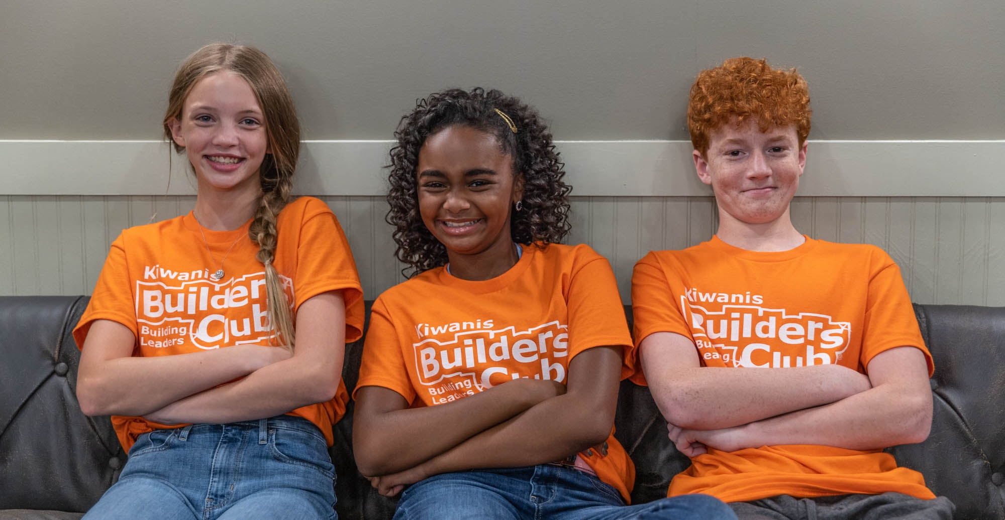
What’s next after K-Kids?
Builders Club!
Notes:
Narration: If you are a K-Kids member who is being promoted to middle school or junior high, you can continue your service leadership journey through Builders Club.

Slide 2
What is Builders Club?
Notes:
Narration: Let’s learn about Builders Club.

Slide 3

A club for young people ages 11-14.
A place to belong and make friends.
A place to serve the community and continue to grow as a leader.
Part of the Kiwanis family.
Notes:
Narration: Builders Club is Kiwanis International’s club for middle and junior high school students. There are nearly 1000 Builders Clubs around the world. Like in K-Kids, it’s a place where you can belong, make friends, and learn more about yourself and your community. It’s the step after K-Kids and before Key Club, in the Kiwanis family’s service journey.

Slide 4
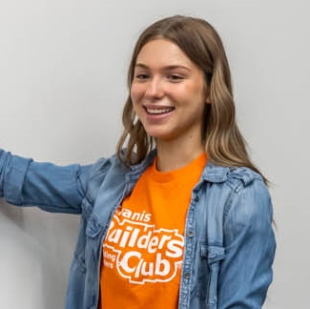

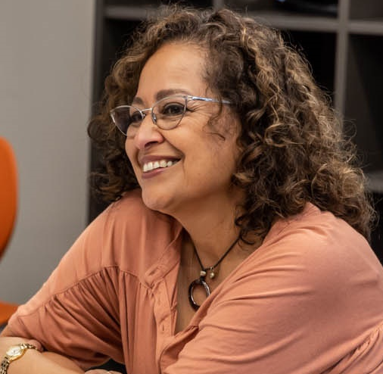
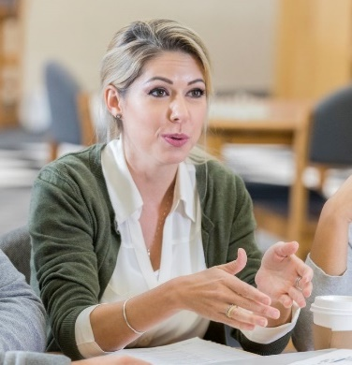

Builders Clubs are made up of:
Members, officers and committee chairs
Faculty advisor
Kiwanis advisor
Host school or organization
Sponsoring Kiwanis club
Notes:
Narration: Students are at the center of Builders Clubs. They are members and, also, run the club as officers and committee chairs. They are usually guided by a faculty advisor (from the host school or organization) and supported by a Kiwanis advisor from the sponsoring Kiwanis club.

Slide 5
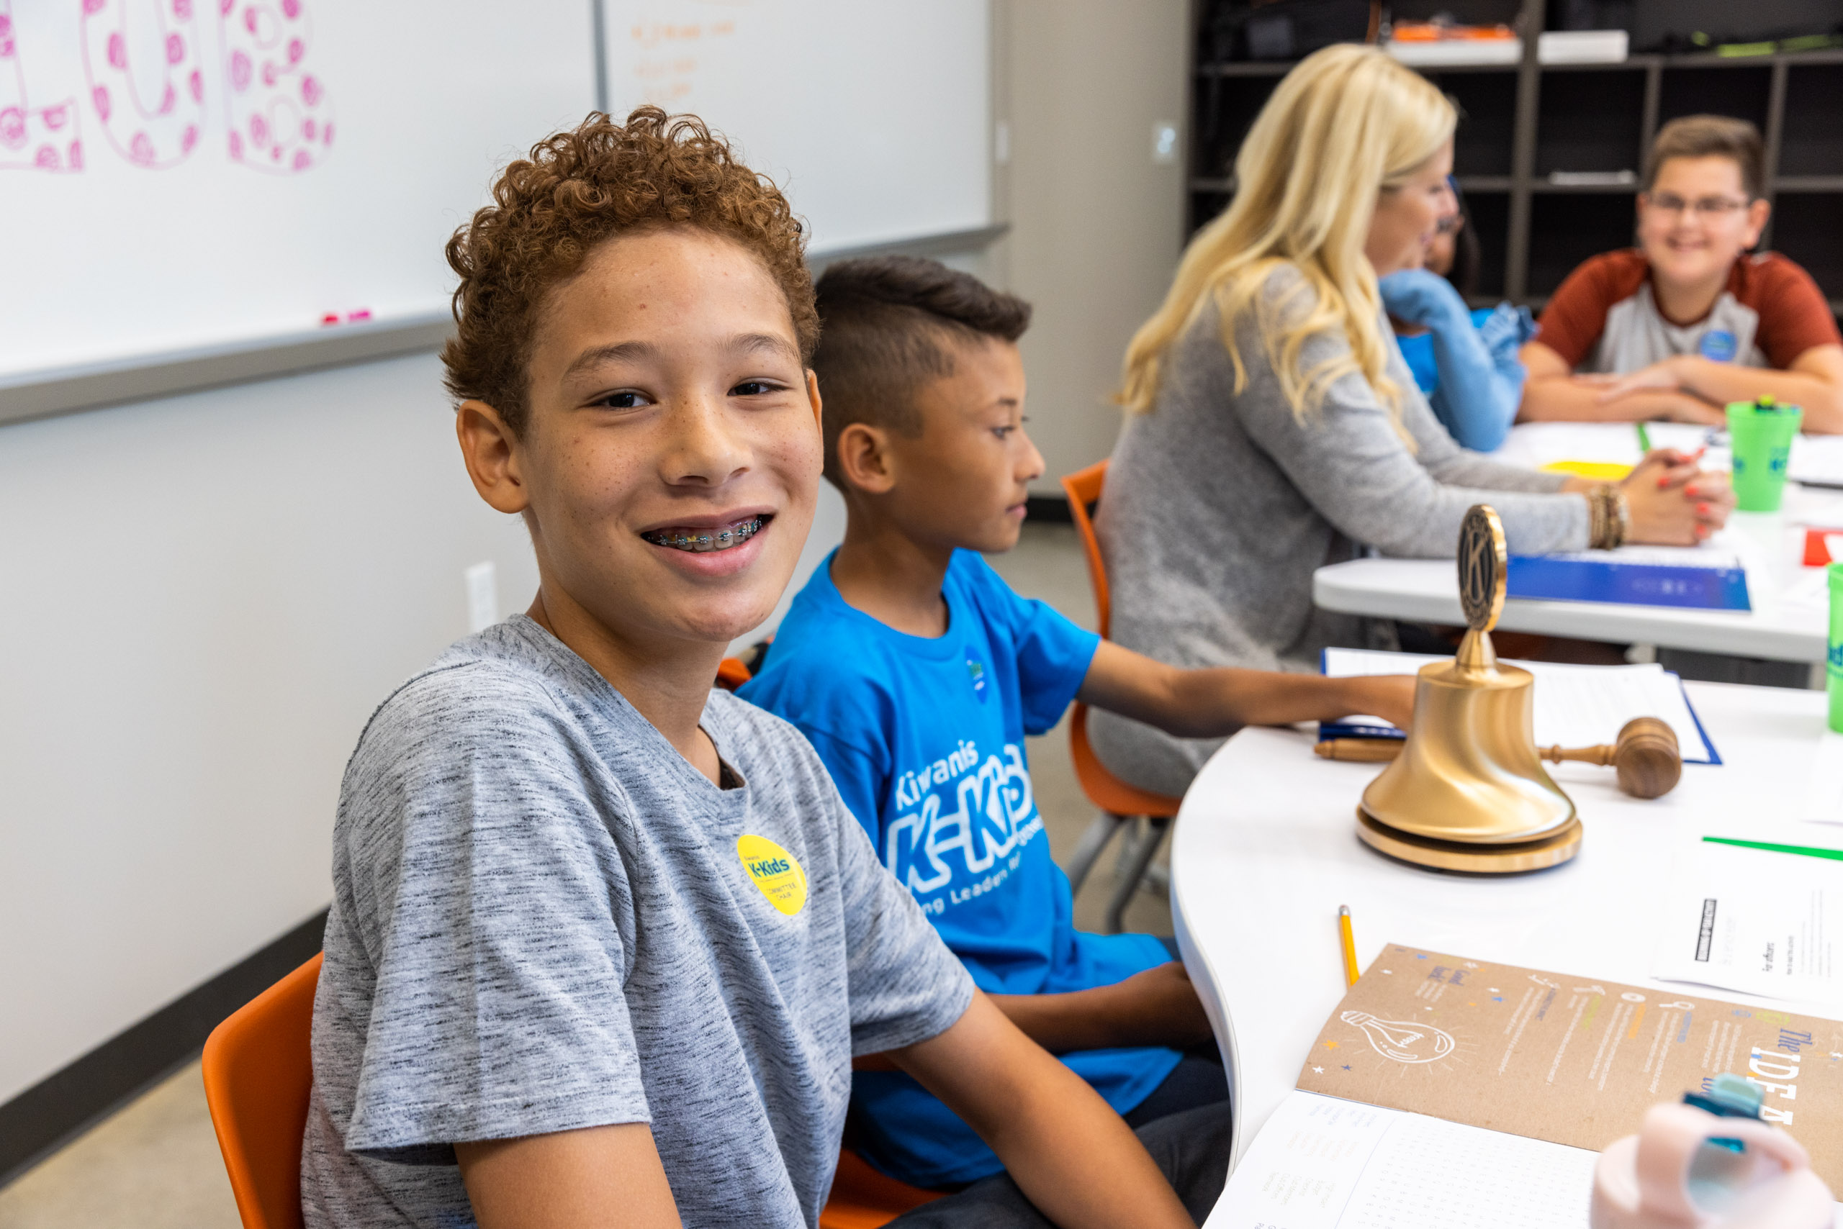
Make an impact as a Builders Club member
Notes:
Narration: You can make a difference in Builders Club!

Slide 6


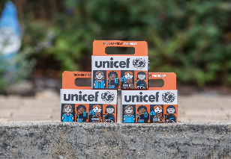
Give time and resources to fill needs and improve communities
Notes:
Narration: Communities, and the world, have urgent needs for basic resources and efforts that improve the lives of people and animals. Like in K-Kids, Builders Club members learn about these needs and carry out service projects to address them. They give their time to serve, raise money and organize donation drives.

Slide 7
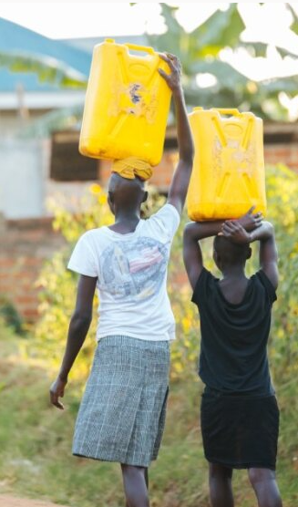
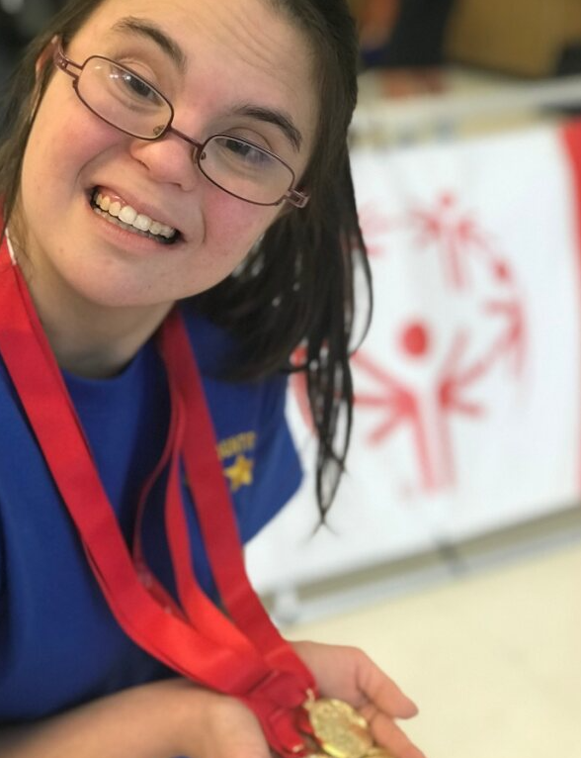

Support causes you care about
Notes:
Narration: In Builders Club, you will help the club decide which causes you want to support. Do you care about people with disabilities and want to fundraise for the Special Olympics? Are you concerned about the environment and want to clean up parks and beaches? Do you want to raise money to build wells because you know 2 billion people don’t have access to clean water?
Whatever the cause, in Builders Club you can plan projects that will help it!

Slide 8
How you’ll grow in Builders Club!
Notes:
Narration: Belonging to a Builders Club provides many benefits to members.

Slide 9
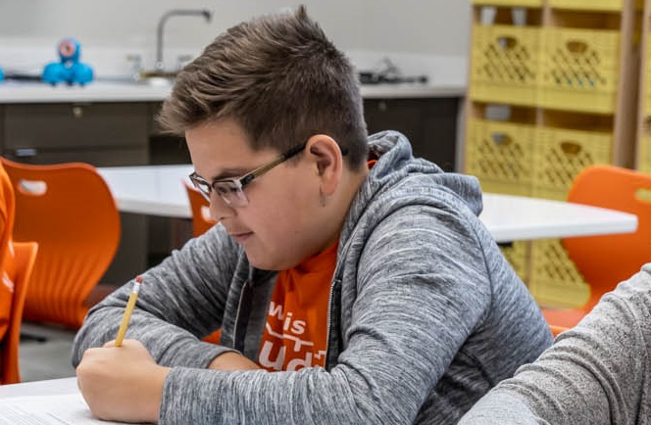


Builders Club creates a positive place to belong
Builds leadership in big and small ways — in members, officers and committee chairs.
Gives students a sense of belonging and confidence.
Promotes positive feelings and behavior.
Notes:
Narration: Builders Club is good place to be! Students feel and act positively. The activities are designed to build leadership and teamwork. Clubs give students a place to belong and gain confidence.

Slide 10
Builders Club will help you build skills
Empathy
Communication
Collaboration
Solving problems​
Setting goals
Planning events
Creating a budget
Making a fundraising request
Notes:
Narration: Club activities will also develop many skills. These include essential life skills like empathy and problem-solving and task-specific skills like goal setting and event planning.

Slide 11
How members describe Builders Club
Fun
Welcoming
Encouraging
Exciting
Collaborative
Creative
Learning
Inclusive
Student-led
Caring
Helpful
Community
Service
Leadership
Life-changing
Notes:
Narration: Members think positively about their experiences. Here are words from member surveys that they used to describe Builders Club. These show they feel belonging, have fun, grow. and care for others. PAUSE FOR VIEWERS TO READ.

Slide 12
What Builders Club members say
“I feel more included in my school and more involved.”
“I learned how to be more confident in my ideas and how to share those ideas with others.”
“I love seeing my teachers and friends at every meeting and I look forward to it every week.”
"Being a part of Builders Club taught me how to give back to the community, and not only how good the people feel when you help them, but also how good and proud you feel that you can also make a difference."
Notes:
Narration: These quotes (and many others) show that members have good feelings and gain benefits from being in their clubs. They learn how to help their community, too! PAUSE FOR VIEWERS TO READ.

Slide 13
Become a Builders Club member!
Notes:
Narration: Here is how to join a Builders Club when you get to middle school or junior high.

Slide 14

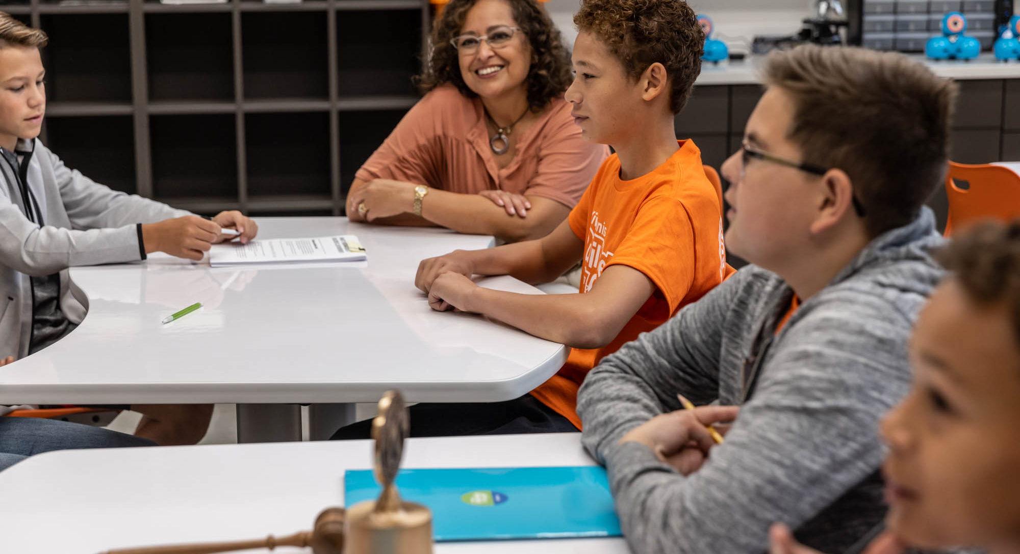
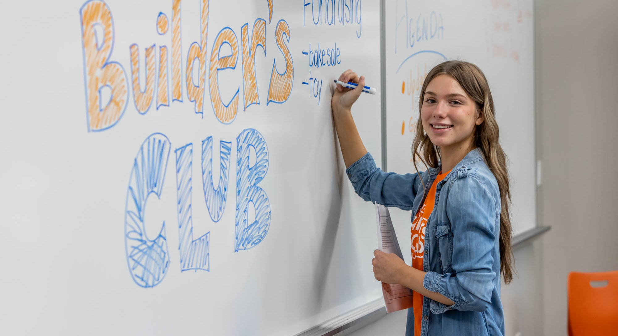
When the middle school has a
Builders Club. Join!
Ask school office staff for the name of the Builders Club faculty advisor.
Meet the advisor and learn about the club. Attend a meeting to see what it’s like.
Join Builders Club! Become a member, run for an officer position or ask how to become a committee chair.
Notes:
Narration: If the new school you’re attending has a Builders Club, it’s easy. Ask school staff for the faculty advisor’s name. Visit the faculty advisor and ask about the club. Find out when and where the club meets and attend a meeting. Then, join!

Slide 15


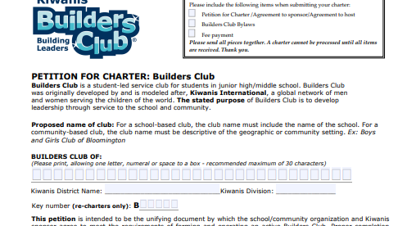
If the middle school doesn’t have a
Builders Club, start a club!
Talk to the middle school/junior high principal. Contact a local Kiwanis Club about starting a Builders Club at the school.
Ask other students about their favorite teacher, counselor or staff member. Find an adult who will be the club’s faculty advisor.
When the school and Kiwanis club have agreed, help them to complete and submit a Petition to Charter form to start the new Builders Club.
Visit buildersclub.org/start-a-club
Notes:
Narration: If the new school you will be attending doesn’t have a Builders Club, you can start one. First, talk to the principal about your desire to start a club.
Then, after you receive permission from the principal to proceed, contact a local Kiwanis club (like the one that sponsored your K-Kids club) to ask if they are interested in sponsoring a new Builders Club. Encourage them to meet with the principal.
Next, find a faculty advisor to help lead the club. Talk to students about a favorite teacher, counselor or staff member they think would be a good advisor. Reach out to these adults until you find one who agrees to serve as the club’s faculty advisor.
Finally, let the advisor know about the “Petition to Charter” form found in the “Start a Club” section of the Builders Club website. The form is an agreement between the host site and sponsoring Kiwanis club and has sections for each partner to complete. After the form is submitted, your new Builders Club is started!

Slide 16

Need help?
Contact the Kiwanis
Service Leadership Program Team at BuildersClub@Kiwanis.org
Notes:
Narration: If you find you need additional help, contact Kiwanis staff at buildersclub@kiwanis.org. We can answer any questions you have!

