Slide 1

What is K-Kids?
Notes:
Welcome. In this presentations, we’ll talk about reasons for a Kiwanis club to sponsor a K-Kids club, how to start a K-Kids, and some basic information on K-Kids clubs.

Slide 2
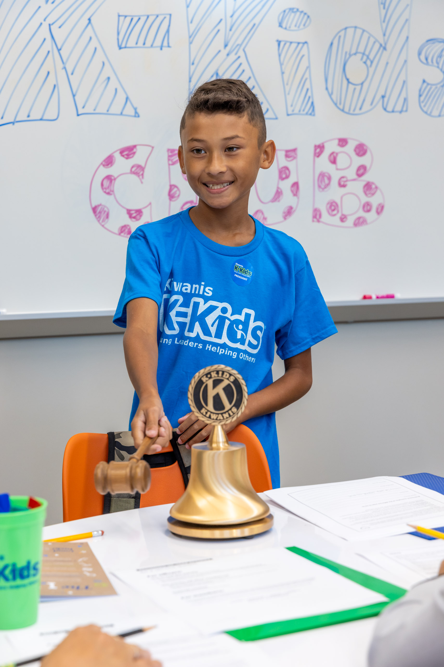
K-Kids members say:
“K-Kids is fun because you can do so many activities and help our community be a better place to live.”
“K-Kids is all about being a leader, you can build your skills and share kindness to the world.”
“A fun club to help support our community and school.”
Notes:
K-Kids members show that they understand the purpose of the program and feel its value. We know this from stories shared by club advisors and from members themselves. Listen to what members have said about K-Kids in annual surveys they complete.

Slide 3
A club for primary/ elementary age kids.
A place to make friends and belong.
A place to learn Kiwanis service leadership and contribute to community.
The first step in the Kiwanis family journey.
K-Kids is…
Notes:
K-Kids is the Kiwanis International club for the youngest of our members – it’s the first step in a lifetime of service in the Kiwanis family. Primary / elementary age students find a place to make friends, and for some, it may be their first experience learning how to serve others and develop leadership skills.

Slide 4
K-Kids Benefits
Kiwanis Clubs
Notes:
Sponsoring a K-Kids club has a number of benefits for a Kiwanis club.

Slide 5
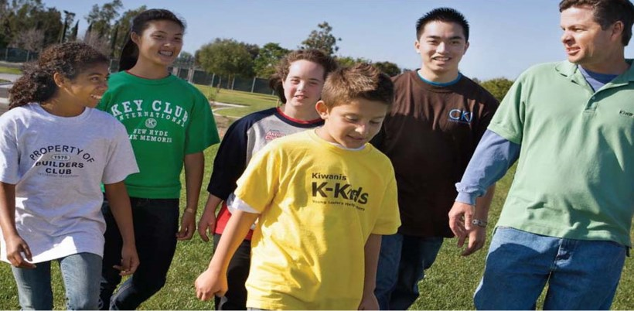
Grow the Kiwanis family, adding the youngest members
Notes:
First, a Kiwanis club that sponsors a K-Kids will add to the youngest members of the Kiwanis family and grow the number of young students doing service in their local community.

Slide 6
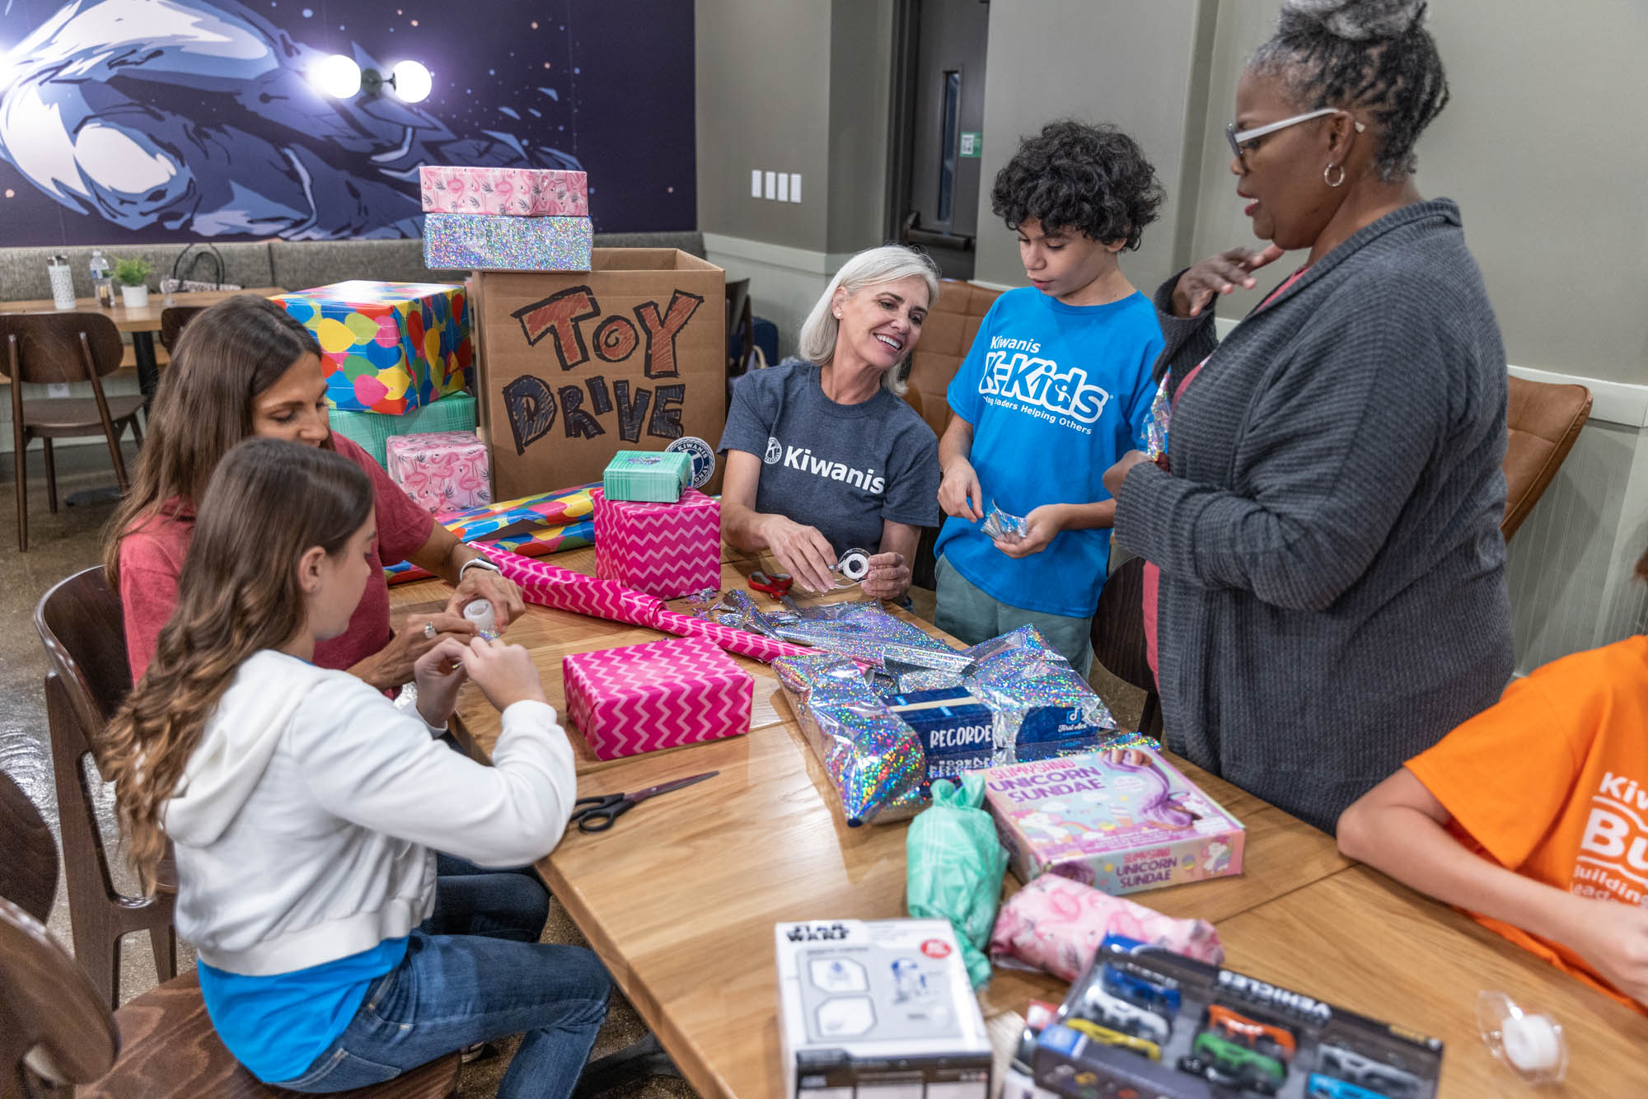
Add opportunity for intergenerational engagement
Notes:
Sponsoring a K-Kids creates opportunities for a Kiwanis member to become the club’s Kiwanis advisor who engages with students during meetings and service. The Kiwanis club can also welcome K-Kids to participate in joint service opportunities. What a great way to celebrate service across the generations!

Slide 7

Introduce adults in schools and organizations to Kiwanis
Notes:
Adults in the host school – from school leaders to teachers to parents – will learn about your Kiwanis club. This is an opportunity for member recruitment!

Slide 8
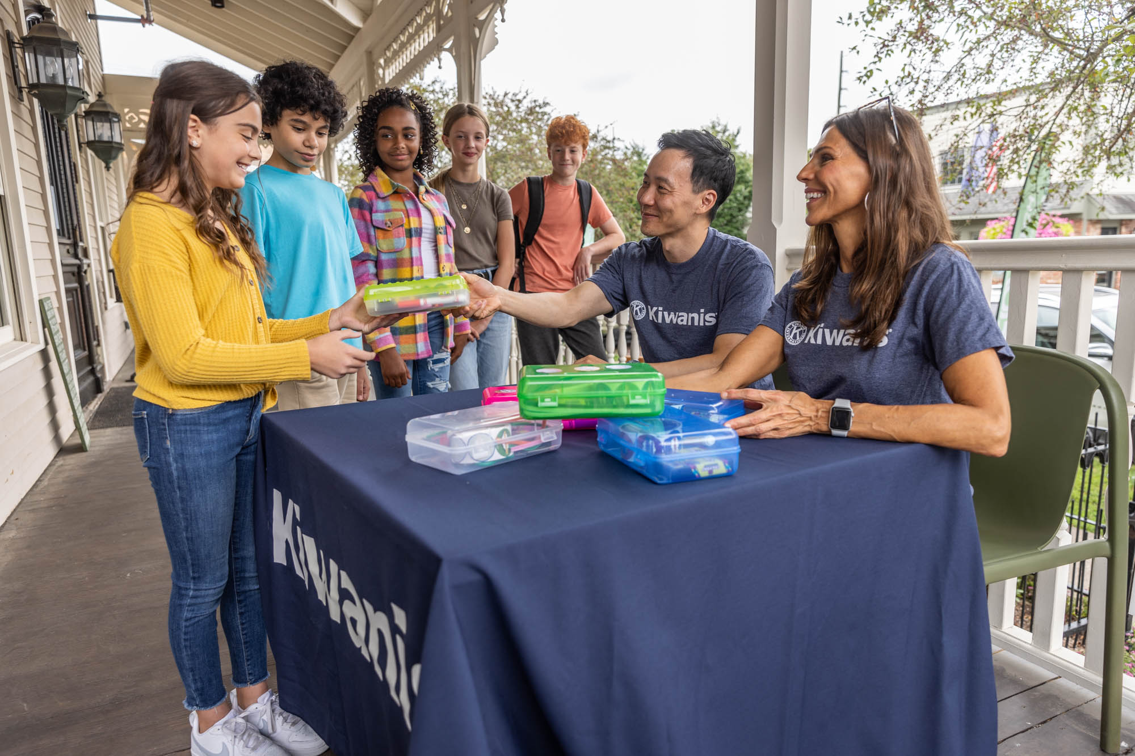
Build club’s visibility, reputation and leadership in the community
Notes:
As your Kiwanis volunteers engage in service with the K-Kids, your Kiwanis club can benefit by greater visibility with organizations and people that don’t know about Kiwanis in your community.

Slide 9
K-Kids Benefits the Community
Notes:
Like Kiwanis clubs, K-Kids makes benefits your community in many ways.

Slide 10


Fill needs and improve communities by contributing time and resources
Notes:
Communities and the world have urgent and ongoing needs for basic resources and things that improve the lives of people and animals. K-Kids members learn about these needs and carry out service to address them. They contribute their time and raise and donate items to fill these needs. They give food, warm clothing, blankets, toiletries, books, pet toys, cards, artwork, and so much more. They clean parks, serve food, organize fundraisers, sponsor donation drives, and more.

Slide 11
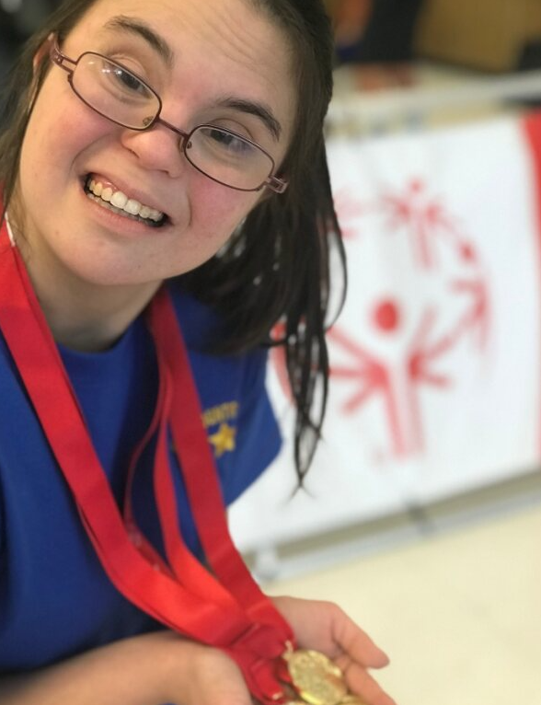
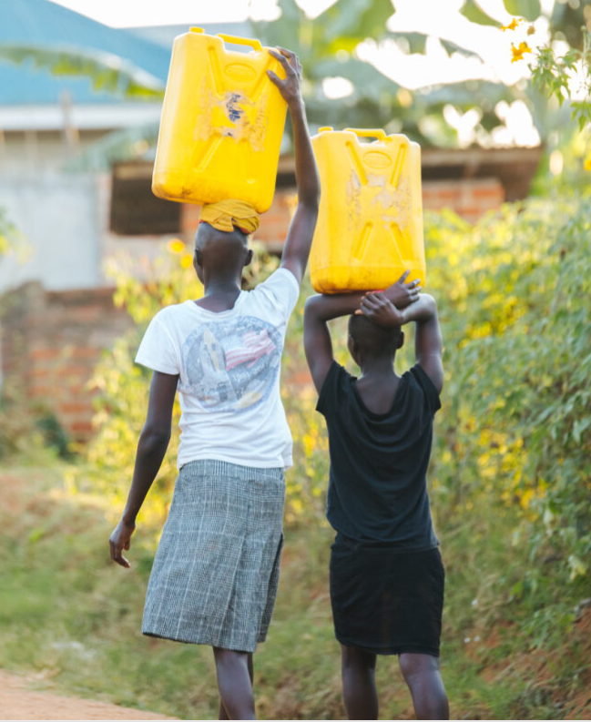

Raise awareness about community and world needs and issues
Notes:
K-Kids clubs also raise awareness by educating people about the many needs and social issues facing communities and the world today. They teach about animals that need homes. They advocate for people with disabilities and the environment. They raise money to build wells while educating people about the billions of humans without access to clean water.

Slide 12
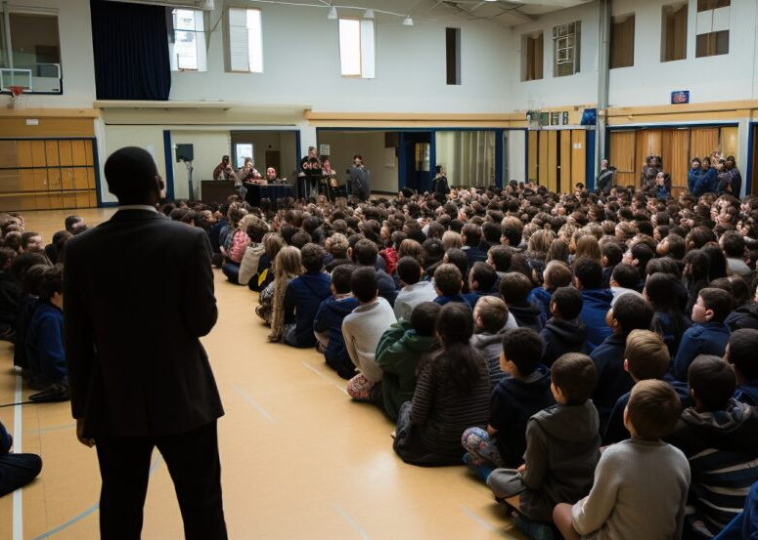
Help youth and schools connect to organizations
Notes:
Having a K-Kids club increases engagement between students and their school or organization and the local organizations or groups they connect with and serve. K-Kids clubs arrange for staff from organizations to speak at club meetings and assemblies; and members educate others about the causes of important organizations.

Slide 13
K-Kids Benefits Youth
Notes:
K-Kids also benefits young students in many ways.

Slide 14

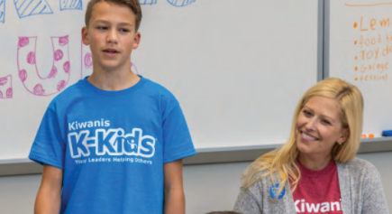
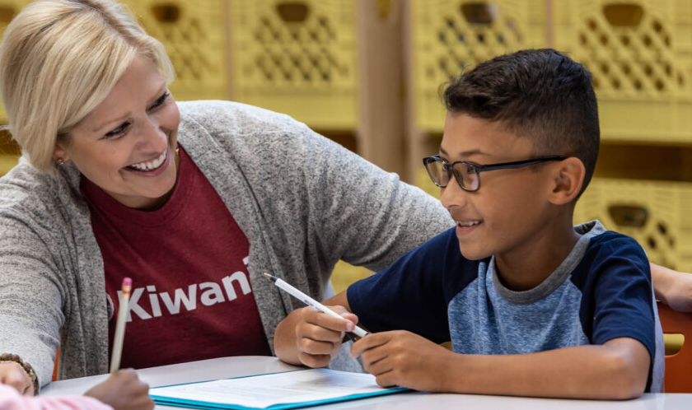
A positive place where kids grow
Promotes positive behaviors (like educational attainment) and decreases detrimental behaviors.
Builds leadership in big and small ways, in club officers, committee chairs and members.
Gives kids a sense of belonging, connection and confidence.
Notes:
Membership in a club promotes positive behaviors for students and decreases detrimental behaviors. K-Kids is designed to teach and build leadership in students, whether they are club officers, committee chairs or members. Even members have opportunities for formal or informal leadership. And, crucial to a youth’s social-emotional wellness, K-Kids offers them a place to belong, to feel connected to other students and adults, and to gain confidence.

Slide 15








Build essential soft and hard skills
Empathy
Communication
Teamwork
Problem solving
Goal setting
Event planning
Creating a budget
Making a fundraising request
Notes:
Built into the many activities for planning service projects and working with others, K-Kids is a learning ground for all kinds of skills. Students develop soft skills like empathy, communication, teamwork, and problem-solving. They also develop hard skills that are task-specific like goal setting, event planning, creating a budget, and making a fundraising request.

Slide 16
Basics of K-Kids clubs
Notes:
Here is some basic information about what K-Kids clubs look like, who is involved and how they operate.

Slide 17

Partnership forms a K-Kids club
School or organization, where the club meets; provides a faculty advisor.
A sponsoring Kiwanis club that pays the K-Kids’ fees and provides a Kiwanis advisor.
Notes:
A K-Kids club is usually formed in partnership between two groups. The first is a school, youth organization, library or community center that will host the K-Kids club. The host site provides members, a meeting space and a faculty advisor for the club. And your Kiwanis club can be the other partner! A local Kiwanis club usually sponsors a new K-Kids. The Kiwanis club pays the charter and annual renewal fees for the K-Kids and provide a volunteer to serve as its Kiwanis advisor. The sponsoring Kiwanis club can also invite the K-Kids to partner on service projects and attend special Kiwanis events.

Slide 18
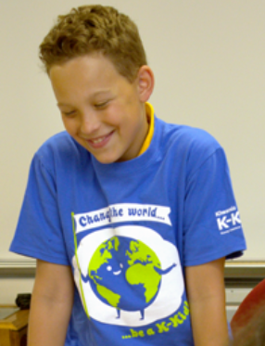
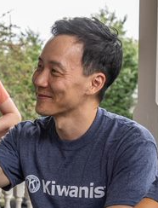
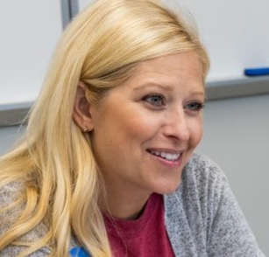



People involved with K-Kids
Faculty advisor
Members, officers and committee chairs
Kiwanis advisor
School or site administrator
Sponsoring Kiwanis club
Kiwanis district administrator
Notes:
Students are at the center of K-Kids clubs. Students are members, officers and committee chairs. Kiwanis recommends at least 15 members in a club. The club has a faculty advisor who communicates with their school or site administrator about the club. Most clubs also have a Kiwanis advisor who supports the K-Kids club and is the liaison to the sponsoring Kiwanis club. The Kiwanis district provides an administrator to support advisors and grow K-Kids clubs in your state or region.

Slide 19
The Faculty Advisor’s Role
Recruit
Recruit members.
Help
Help members use talents, build skills and learn service leadership.
Mentor
Mentor officers, chairs & members.
Follow
Follow school/site procedures and Kiwanis youth protection policies.
Submit
Submit surveys & reports.
Be a team
Work with Kiwanis advisor.
Liaison
Be a liaison to school/site leadership.
Notes:
The faculty advisor has the primary role in ensuring a club has members, meets regularly and carries out service projects. They recruit members, help them understand their talents and build their skills. The faculty advisor serves as a mentor and guide. The faculty advisor is a teacher, staff member, coach or other adult affiliated with the host site. They work with the Kiwanis advisor to determine how they will help with the club, to keep them informed, and to share updates for the sponsoring Kiwanis Club. The faculty advisor is familiar with the school or organization’s procedures and acts as liaison between the K-Kids club and school administration.

Slide 20
The Kiwanis Advisor’s Role
Attend K-Kids meetings and service events.
Meet with faculty advisor to determine specific responsibilities.
Follow school/site procedures and Kiwanis youth protection policies.
Be the liaison with the Kiwanis Club – extend invirations, share K-Kids’ progress and needs.
Update
At start of each year, update Kiwanis club secretary on information to get program kit ordered.
Be a team
Attend
Liaison
Follow
Help
Help with activities, like officer training, service events and making community connections.
Notes:
A big part of the role of Kiwanis advisor is being present and attending meetings and service events. It’s important to meet with the faculty advisor at or before the beginning of the service year to determining how to help the club. For example, Kiwanis advisors can help train officers and can make connections for the club to community organizations and guest speakers. They can help complete the Annual Achievement Report and contest submissions.
A very important role for the Kiwanis advisor is also serving as the liaison between the Kiwanis club and the K-Kids club. At the beginning of the year, they can communicate with the Kiwanis club secretary to provide important information including the membership count so the secretary can renew the K-Kids club to get the club’s program kit ordered and shipped.

Slide 21



Club meetings and locations
.
How: Clubs meet weekly, twice a month or monthly. Advisor–officer.
When: The new service year starts at the beginning of your school year.
Where: Nearly 1000 clubs worldwide with 23,000 members.
Notes:
Club meetings held weekly, twice a month or monthly or another frequency that makes sense for the faculty advisor availability and time available for activities at the school or host site.
The new service year starts at the beginning of a club’s school year. At Kiwanis, we have new program kit materials ready to ship and start Service Leadership Program activities (like newsletters and training) at the beginning of the North American school calendar in August and September.
As of 2022, there are nearly 1000 K-Kids clubs worldwide with about 23,000 members.

Slide 22

What Kiwanis International provides
Dedicated staff develop club programming.
Advisor
e-newsletters.
Website with resources and awards information.
Data collection to improve programs.
Youth Protection training and background checks for Kiwanis volunteers & club advisors.
Liability insurance coverage for clubs.
Advisor training.
Annual K-Kids program kit with advisor and member materials.
Notes:
Kiwanis International SLP staff offers lots of support for K-Kids clubs and their advisors. This support is made possible through the charter and annual renewal fees paid by sponsoring Kiwanis clubs.
Dedicated staff that develops club resources and programming.
A club program kit with resources sent to clubs (in North America and the Caribbean) annually.
K-Kids website with many service leadership resources, recruitment resources, awards information, and more.
E-newsletters and virtual training for advisors.
Youth protection training and support.
Liability insurance to protect members and advisors.

Slide 23
How to Start a K-Kids Club
Notes:
Here is how to start a K-Kids club.

Slide 24
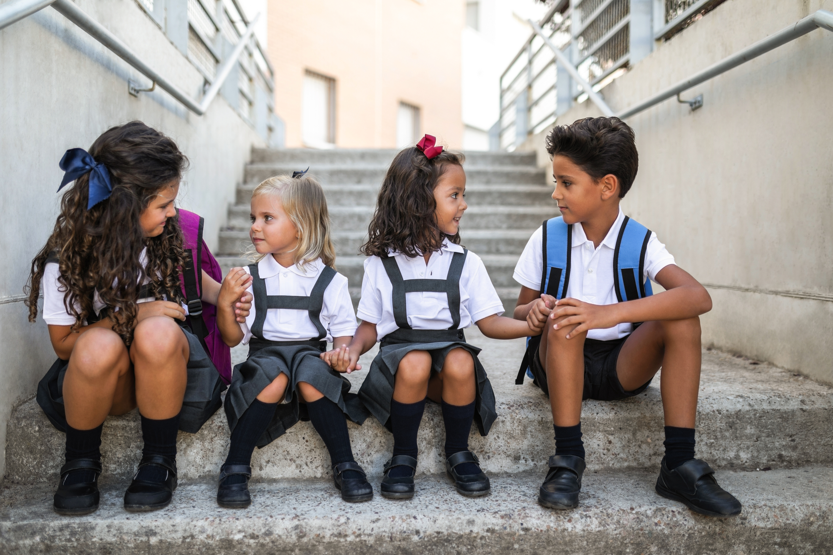
Find a partner to host the club
Notes:
There are just two steps for your Kiwanis club to take to start a new K-Kids club! The first is to find a site that wants to host a K-Kids club for its students or young members. This can be a primary/elementary school, a youth organization (like a Boys and Girls Club or YMCA), a community center, a library, a homeschooling group, congregation or other place where young kids meet. Consider reaching out to your members to find those who have a relationship with a school or other potential site to help you start a conversation. Also, remember that a Key Club or a Circle K club may also co-sponsor a K-Kids club. So, if your Kiwanis club sponsors a Key Club or CKI, invite them to help!

Slide 25
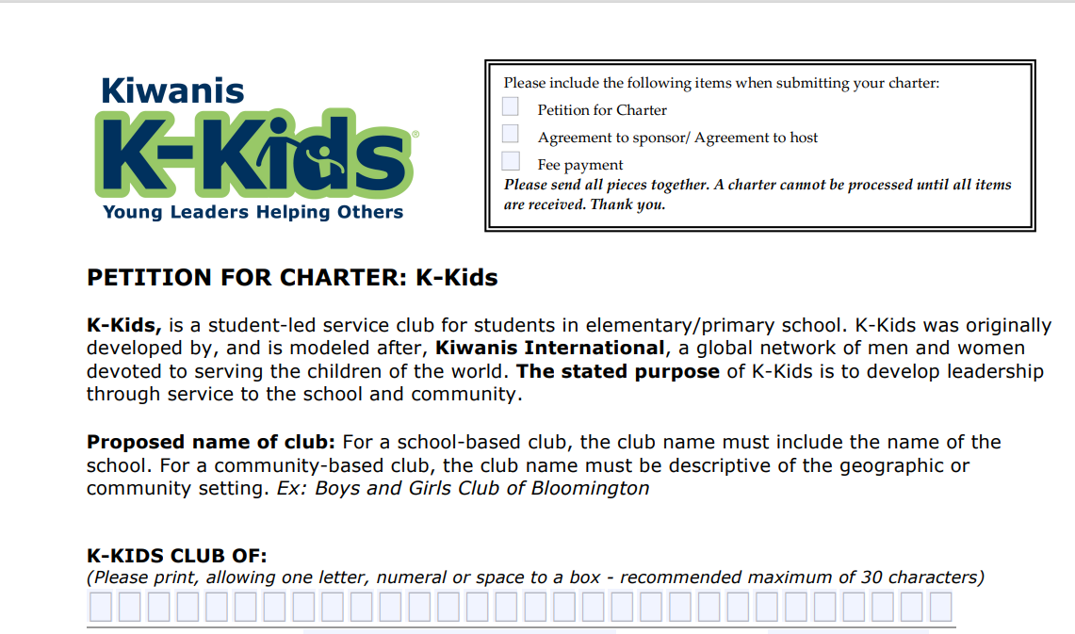
Complete the “Petition to Charter”
Visit kiwaniskids.org/
start-a-club/
Notes:
Once your Kiwanis club has identified a school, youth organization or other community-based place that wants to host a K-Kids, work with your partner to complete the Petition to Charter. This form is found in the “Start a Club” section of the K-Kids website. The form is an agreement between the host site and sponsoring club and has sections for each partner to complete. The final step is for your Kiwanis club secretary to submit the form to Kiwanis International, accompanied by the club chartering fee.

Slide 26
Cost to charter & maintain a K-Kids club
  Chartering fees:
    North America/Caribbean & Tier A: US$300
    Tier B (outside NA/Caribbean): US$200
    Tier C (outside NA/Caribbean): US$150
  Annual (renewal) fees:
    North America/Caribbean: US$215
    Tier A (outside NA/Caribbean): US$50
    Tier B and C (outside NA/Caribbean): US$25
For questions, contact slpchartering@ kiwanis.org
Notes:
The cost for starting a K-Kids club in North America and the Caribbean is US$300 for the chartering fee. For other countries, contact slpchartering@kiwanis.org to find out which tier your country belongs to and the cost for chartering a K-Kids in your country. The annual renewal is lower for clubs outside the U.S., Canada and the Caribbean because they do not receive program materials after their initial charter kit.
Bring Up Grades, or BUG, recognizes elementary students who raise their grades or maintain good grades from one grading period to the next.
Students are motivated to achieve because they set their own goals and participate in peer mentoring, which involves everyone in their success.
When they reach their goals, the entire class celebrates. Kiwanis clubs and members are key to ensuring that the students feel supported in their efforts and recognized appropriately for their achievements.

Slide 27
Resources for K-Kids Clubs
Notes:
The resources Kiwanis International has created for K-Kids clubs are based on research around high-quality service and healthy youth development. They provide a foundation of understanding about self and community.

Slide 28
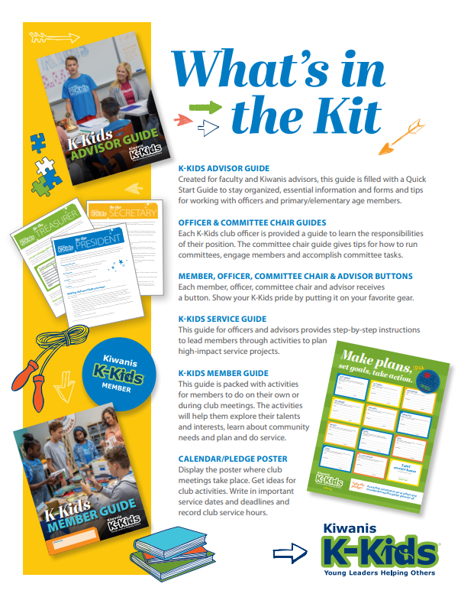
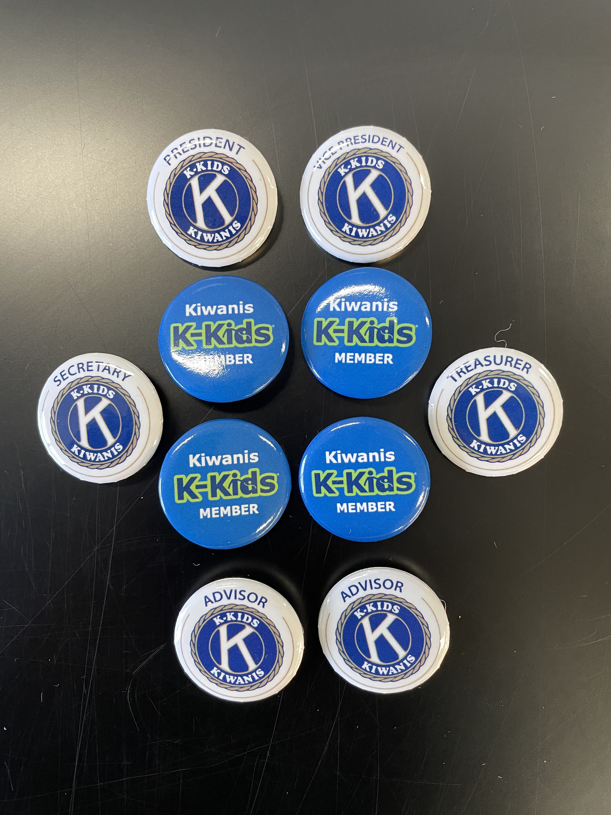
The K-Kids Program Kit
Notes:
Your sponsorship of a K-Kids provides the club with the K-Kids program kit. This kit contains guides for members, advisors, officers and service, as well as buttons and other resources. Program Kits are shipped AFTER Kiwanis receives the club’s charter or renewal fee, member quantities and shipping information from the sponsoring Kiwanis club’s secretary.

Slide 29
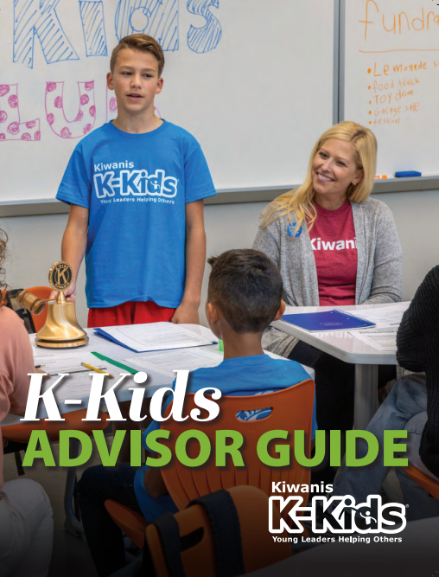
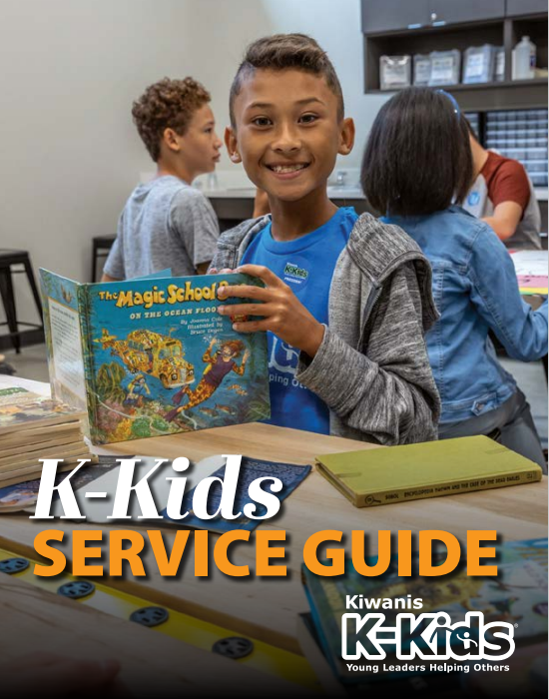
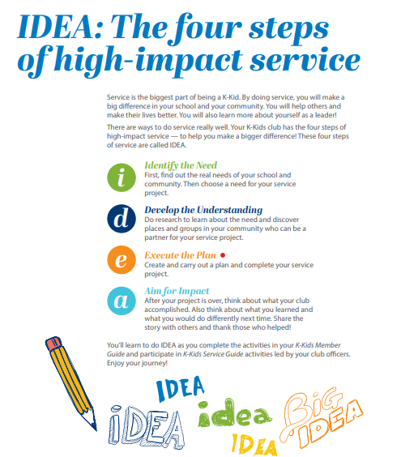
Guides for advisors and officers to lead
The K-Kids Advisor Guide:
The advisor’s primary resource!
Notes:
The main resources in the program kit are three guides. The K-Kids Advisor Guide offers guidance on how to run a club, the roles of officers and committee chairs, tasks to complete throughout the year, and more. The K-Kids Service Guide is chock full of the activities with step-by-step instructions to help officers and advisors lead members through the steps of high-quality service.

Slide 30
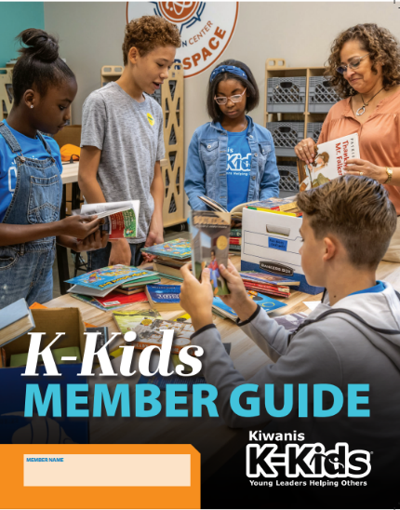
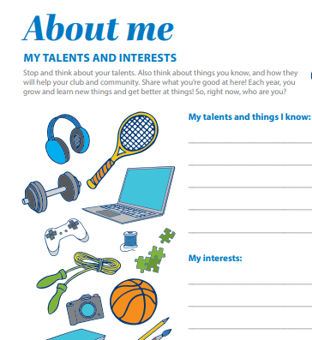
Helping members learn and take action
K-Kids Member Guide
Notes:
And each member receives a K-Kids Member Guide. This guide helps members better understand themselves and others. For example, the activity shown here shows how the guide helps members recognize their talents and interests; they later go on to decide how to use their knowledge and skills for service. Members also learn how to set and achieve goals.

Slide 31
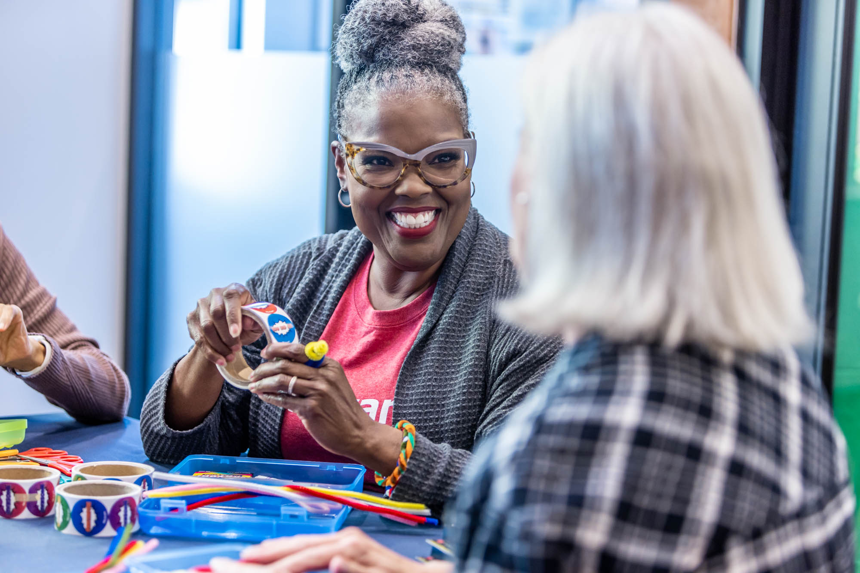
Start a K-Kids club today!
Notes:
Now that you’ve learned about K-Kids, consider how starting a K-Kids club will benefit your Kiwanis club, its members, the local community and its youngest kids.

Slide 32

Service Leadership Program Staff
Luana Nisan
Luana Nissan
SLP Manager
lnissan@kiwanis.org
a J. Pyron
Lisa Pyron
SLP Development Specialist
lpyron@kiwanis.org
Notes:
Kiwanis’ SLP staff can answer questions the role of a Kiwanis club in chartering and supporting a K-Kids club. This is their contact information. Thank you!

