Slide 1
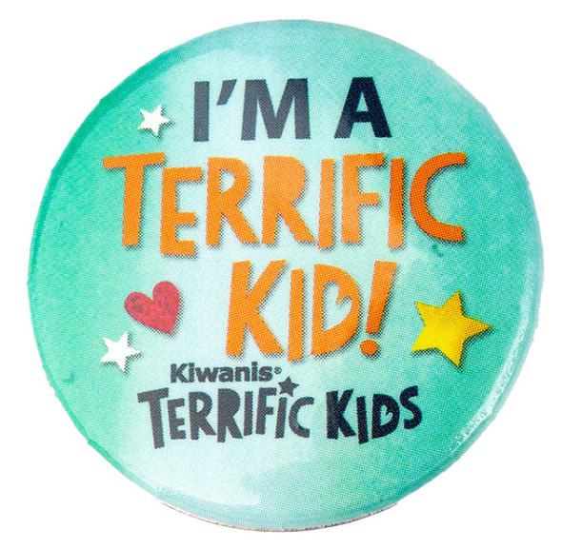
Kiwanis Youth Programs
Notes:
Let’s learn about Kiwanis Bring Up Grades and Terrific Kids programs.

Slide 2
Bring Up Grades
Empowering young students in their academic success:
Recognizes students who raise their grades or maintain good grades from one grading period to the next.
Students set their own goals and participate in peer mentoring, which involves everyone in their success.
When they reach their goals, the entire class celebrates.
Primary/elementary school
Ages 6 - 12
K-Kids.org/bringupgrades
Notes:
Empowering kids in their academic success
BUG recognizes elementary students who raise their grades or maintain good grades from one grading period to the next. Students are motivated to excel because they set their own goals and participate in peer mentoring which involves their classmates in their success. When they reach their goas, the entire class celebrates.

Slide 3
Terrific Kids
A character-building program for young students:
A student-recognition program for attendance, character, behavior and relationships.
Students develop self-esteem, learn perseverance and gain important life skills that help them make smarter choices.
When they reach their goals, the entire class celebrates.
Primary/elementary school
Ages 6 - 12
K-Kids.org/TerrificKids
Notes:
A character-building program
This program recognizes students for modifying their behavior. The program encourages kid to become the bet version of themselves. Participants determine what being terrific means to them then develop their own goals and use peer mentoring to hold themselves accountable for the actions they take each week. When a participant achieves their goal they are honored for be a Terrific Kid.

Slide 4
How do Kiwanis programs help youth
thrive?
Notes:
So, how do these programs help? Share this information with administrators of the school you hope to serve.

Slide 5
Programs work because students
Compete with self to achieve goals, not others.
Actively participate in selecting goals.
Practice self-compassion which fosters resiliency.
Build positive relationships and a caring classroom community.
Identify and embrace their strengths & weaknesses.
Help everyone succeed through peer mentoring.
Notes:
Programs work because students
Compete with self to achieve goals, not others.
Actively participate in selecting goals.
Practice self-compassion which fosters resiliency.
Create a welcoming, caring classroom community.
Identify and embrace their strengths & weaknesses.
Help everyone succeed through peer mentoring.

Slide 6
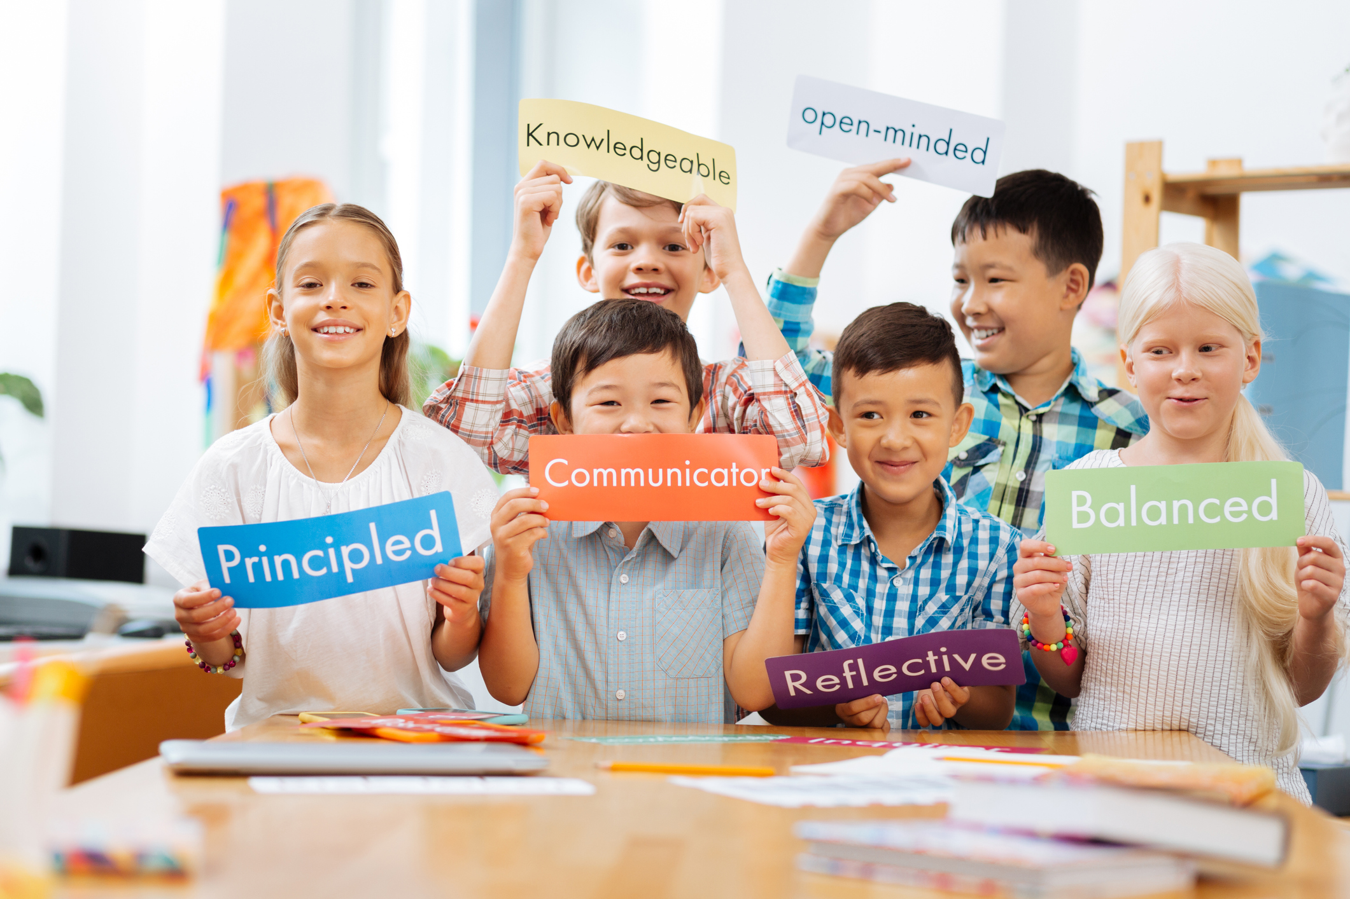
Participants develop skills
Notes:
What skills do Bring Up Grades and Terrific Kids participants master?

Slide 7
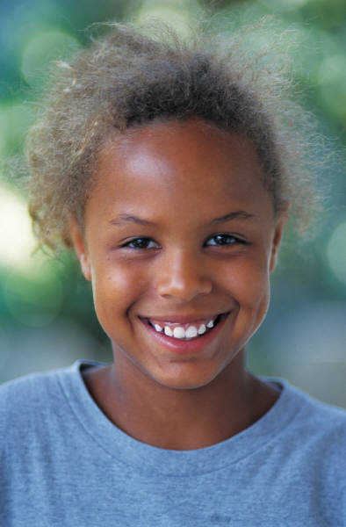
Social Emotional Skills
Self-awareness
Self-management
Responsible decision-making
Social awareness
Relationship skills
Notes:
When used in the classroom BUG and Terrific Kids build a sense of community. Students feel comfortable working together to achieve goals and develop better relationships with one another. They also learn about their strengths and weaknesses and how to set positive goals to make positive changes. Doing these things help them grow more in tune with self and others therefore developing a strong Social and Emotional skill set.
Social Emotional Skills
Self-awareness – Knowing what we think and feel, and how thoughts and feelings influence actions and choices.
Self-management – Learning how to handle challenging emotions so that they don’t cause problems; being able to set goals and deal with obstacles.
Responsible decision making – Being able to identify solutions to problems and consider the consequences of actions on ourselves and others.
Social awareness – Understanding the thoughts, feelings, and perspectives of others and developing empathy.
Relationship skills – Being able to work through conflicts; having strong connections to other people and resisting negative peer pressure.

Slide 8
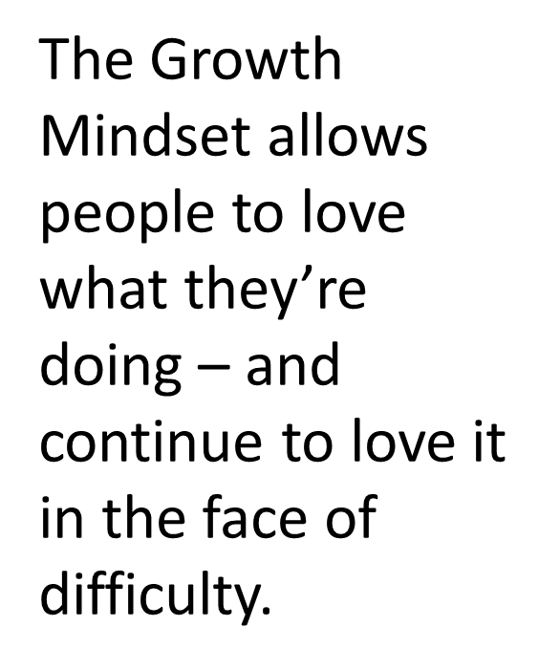
Growth Mindset
Notes:
Terrific Kids and Bring Up Grades promote resiliency by teaching students a growth mindset. Students support each other when goals are achieved and when they are not. When a student struggles everyone works to support that person to regroup and try again. This builds resiliency. Resilient students are better able to deal with day-to-day challenges.

Slide 9
Things to consider
before starting a program.
Notes:
Here are some things to consider before starting a Bring Up Grades or Terrific Kids program.

Slide 10
Ask these questions
Will the program be established at one or more schools?
What are the needs of the school(s)? Ask and listen. Which program is a better fit? Bring Up Grades or Terrific Kids?
Are funds available to support starting a Bring Up Grades or Terrific Kids program?
Notes:
Will the program be established at one or more schools?
What are the needs of the school(s)? Ask the school and listen.
Are funds available to support starting the BUG or Terrific Kids program?

Slide 11
How will we fund the program?
How will funds be raised to deliver the program? Grants? Fundraising events? Business sponsors?
Will the club partner with another Kiwanis family club?
Will the school Parent Teacher Association (PTA) or Parent Teacher Organization (PTO) assist with funding and program delivery?
Notes:
How will funds be raised to deliver the program? Grants? Fundraising events? Business sponsors?
Will the club partner with another Kiwanis family club?
Will the school Parent Teacher Association (PTA) or Parent Teacher Organization (PTO) assist with funding and program delivery?

Slide 12
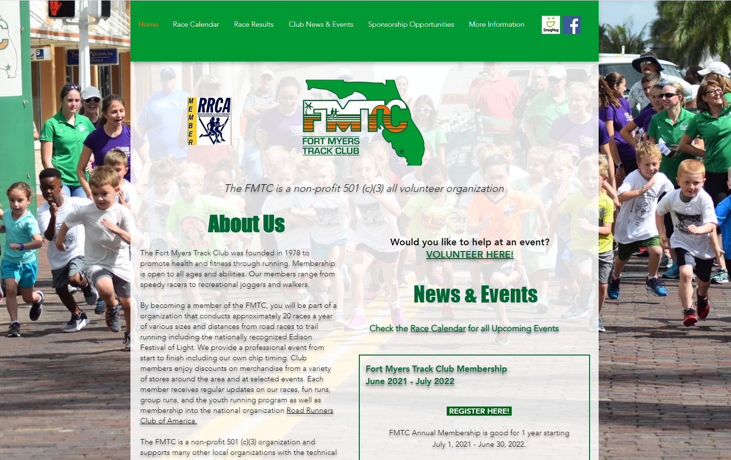
Fundraising example
14th annual BUG Chase 5K run
Fort Myers Metro-McGregor Kiwanis BUG Chase 5K | 1/22/2022
Results (finish photo/video) | Awards | Results | Photo Gallery
Notes:
Here’s a great Fundraising example from the Fort Myers Metro-McGregor Kiwanis Club
Flyer copy: 5K Run at Calusa Nature Center & Planetarium Supports Kids Bringing up Grades
FORT MYERS, Fla. (Dec. 1, 2021) – The Fort Myers Metro-McGregor Kiwanis will hold the 14th annual BUG Chase 5K run on Jan. 22, 2022 at the Calusa Nature Center & Planetarium located at 3450 Ortiz Avenue in Fort Myers. The race will benefit the Fort Myers-Metro Kiwanis Club’s BUG (Bring Up Grades) program and other local club sponsored youth service projects. Participants can register online at www.ftmyerstrackclub.com. In the past there were 400 registered runners.
Race sponsors include Passarella & Associates and Weinstein Wilkes Financial Group. Calusa Nature Center & Planetarium has committed to an in-kind sponsorship. Sponsorship opportunities are now available starting at the $100 level.
The course, supervised by the Fort Myers Track Club, travels the trails at the nature center and a portion of the asphalt bike path on Ortiz and will be timed with Chrono Track Bib Tag Technology. Packet pick up will take place 10 a.m.-1 p.m. on both Jan. 15 at United Way of Lee, Hendry, and Glades and Jan. 16 at Mills-Price & Associates. Race day packet pick up will take place from 7 a.m.-7:45 a.m. Race day registration begins at 7 a.m. and race time is 8 a.m. Adult pre-registration up to Dec. 10 is $25, Dec. 11- Jan. 21 registration is $30 and race day registration is $35. Youth (17-and-under) discounted pre- registration is $15, Dec. 11- Jan. 21 registration is $20 and race day registration is $25. The first 200 runners registered will be guaranteed a short-sleeve commemorative t-shirt in performance material, race bag and refreshments. Runners must register by Dec. 10th to ensure their t-shirt size. The first 100 youth (17-and-under) to register will also receive a finisher medal. Overall and age group awards for the 5K run will be presented. Due to the nature of the course, registrations will be capped at 400 runners. There will be additional parking available at the Regional Cancer Center.
All proceeds benefit the Fort Myers Metro-McGregor Kiwanis BUG (Bring Up Grades) program, designed to provide recognition to local elementary students who raise their grades to an acceptable range and maintain or continue to raise them from one grading period to the next, and other local club sponsored youth service projects. The Fort Myers Metro-McGregor Kiwanis currently has BUG programs at Littleton Elementary School, Orangewood Elementary School and Rayma C. Page Elementary School.
The Fort Myers Metro-McGregor Kiwanis Club also supports the following sponsored leadership programs: Aktion Club at LARC, Key Club at FSW Collegiate High, Builders Club at Cypress Lake Middle and K-Kids at Littleton Elementary. The club built multi-sensory rooms at Tropic Isles Elementary, NFM Academy for the Arts, Heights Elementary and Rayma C. Page Elementary. The Fort Myers Metro-McGregor Kiwanis Club supplies a world atlas to either every fourth or third grade student at the following schools: Rayma C. Page Elementary, Heights Elementary, Orangewood Elementary and Littleton Elementary. The club built and supports a reading oasis and reading mentoring program at Orangewood Elementary.
The Fort Myers Metro-McGregor Kiwanis club also supports many other organizations including the SWFL MS Support Group, Pine Manor Improvement Assn., March of Dimes, The Salvation Army, Ronald McDonald House, Johns Hopkins All Children’s Outpatient Care, Early Learning Coalition of SWFL, Children’s Advocacy Center, Children's Network of SWFL, Healthy Start SWFL, United Way, Lee, Hendry & Glades and more.

Slide 13
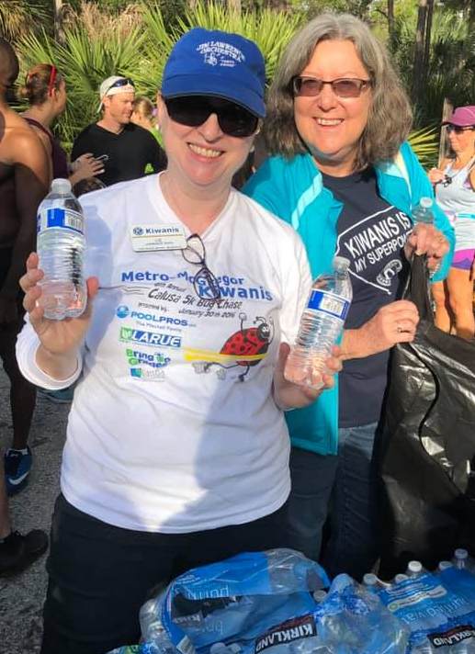
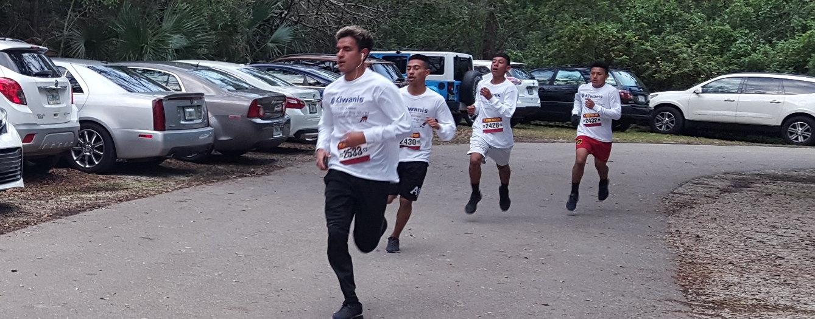
14th annual BUG Chase 5K run
Notes:
More photos from the 14th annual BUG Chase 5K run.

Slide 14
Grant opportunities
Notes:
Research grant opportunities to help your club support a Bring Up Grades or Terrific Kids program. Here are some suggestions.

Slide 15
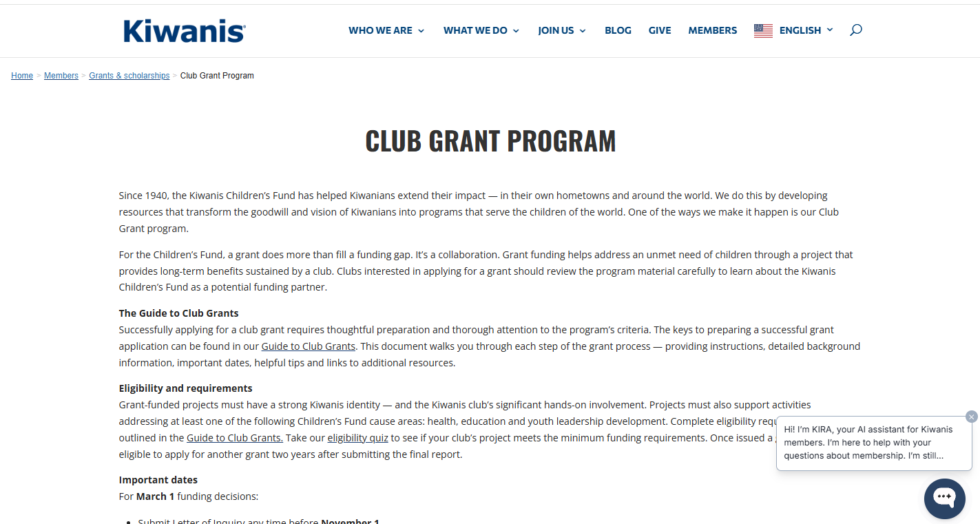
Kiwanis Children’s Fund Grant
kiwanis.org/grants-scholarships/club-grant-program
Notes:
Think about applying for funding through the Kiwanis Children’s Fund. Research grant guidelines online.

Slide 16
District Grant Opportunities
Research grant opportunities available from your Kiwanis district foundation.
Notes:
Be sure to reach out to the Kiwanis district and ask about available grant funding. This is an example of a grant available from the Indiana Kiwanis District.

Slide 17
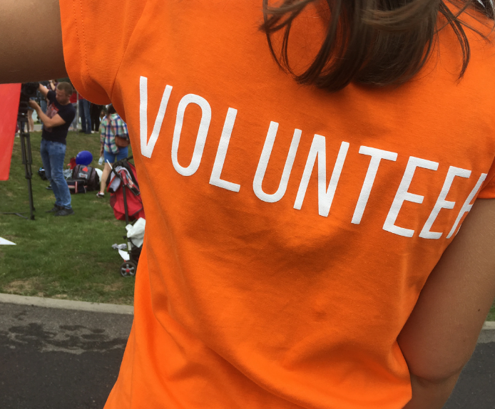
Business sponsorship
Become a Terrific Kids or BUG sponsor and your business name goes here.
Notes:
Fund the program by partnering with business volunteers. Reach out to local businesses interested in connecting with the school. Ask the to support the program, perhaps sponsor the program and purchase T-shirts as BUG recognition.

Slide 18
Partner with another club
Notes:
When delivering the Bring Up Grades or Terrific Kids programs any of the Kiwanis family clubs can help. Partner with one or more Kiwanis clubs and split the cost of the program. If you’re currently sponsoring a K-Kids or Builders Club at a school where your club is soon planning to start a BUG or Terrific Kids program let the service club help with recognizing BUG and Terrific Kids recipients. Key Club and Circle K can also assist with implementation of these programs.

Slide 19
Implement the program
Notes:
Now that your club has secured funding to move forward with the Bring Up Grades or Terrific Kids program, follow these tips to get things going smoothly.

Slide 20
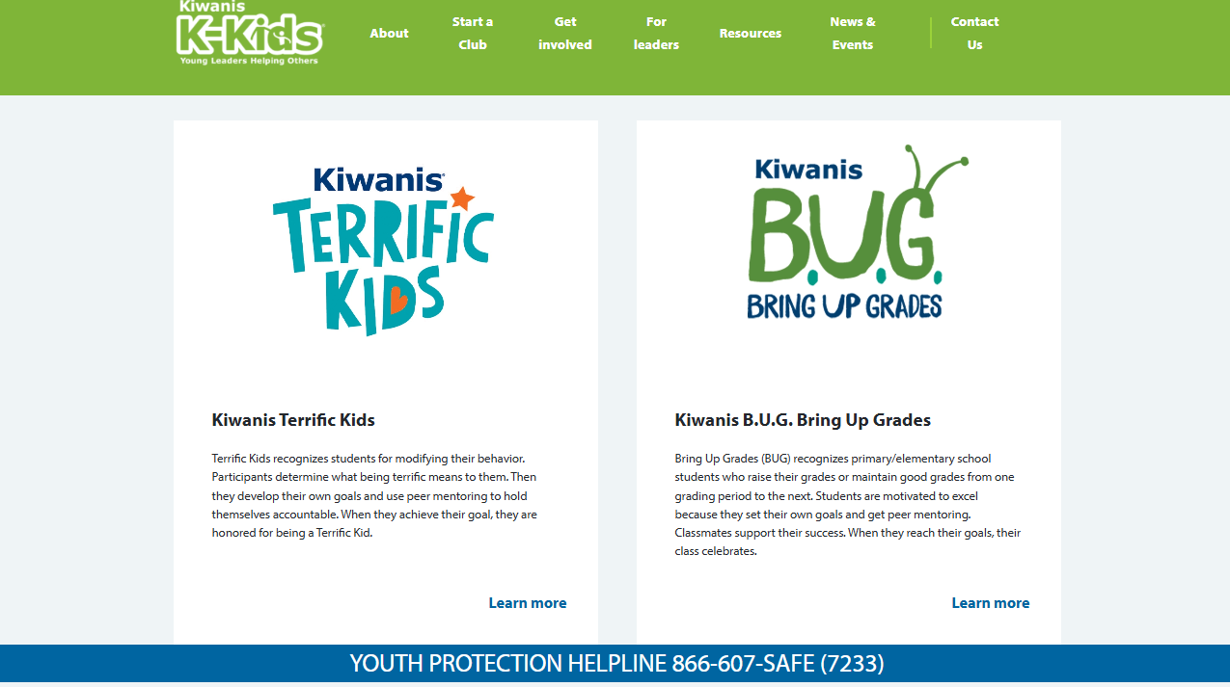
Review program materials
K-Kids.org
Review online materials and learn about the program.
Notes:
Review readable program materials online to understand how each program can be used in the classroom. You’ll find the following information online for each program.
Program materials to review : Teacher/ Facilitator Guide, Student Guide, Goal Planner Guide, Parent Guide, Sponsor Guide.

Slide 21
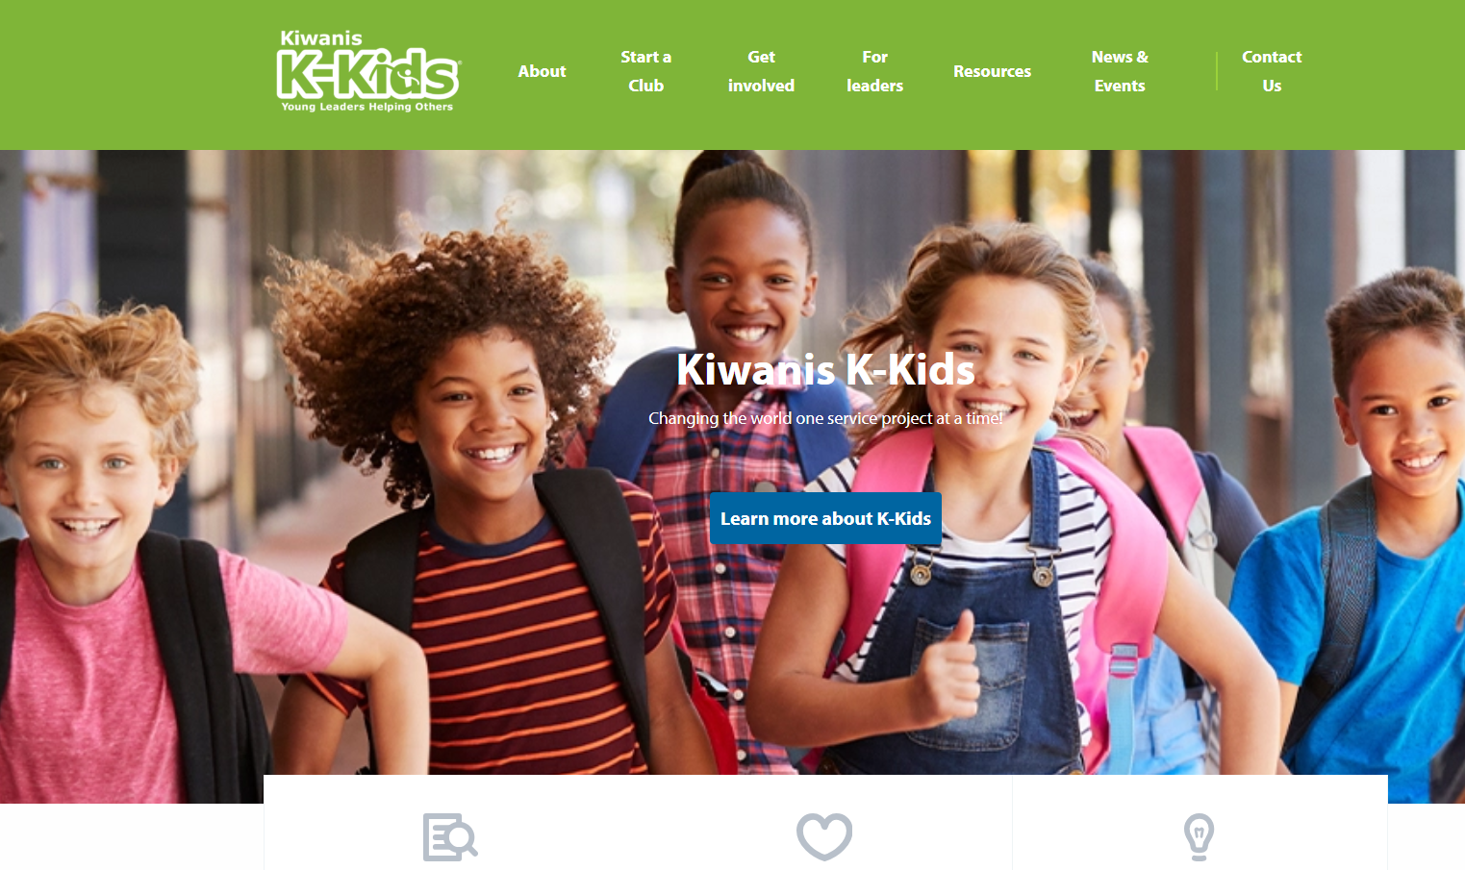
Start at K-Kids.org
Notes:
Find all the information needed to start a program by visiting K-Kids.org.

Slide 22
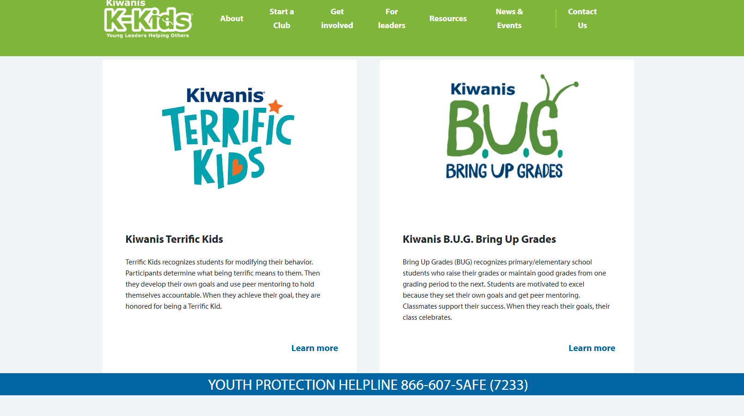
Scroll to the bottom of the page

Slide 23
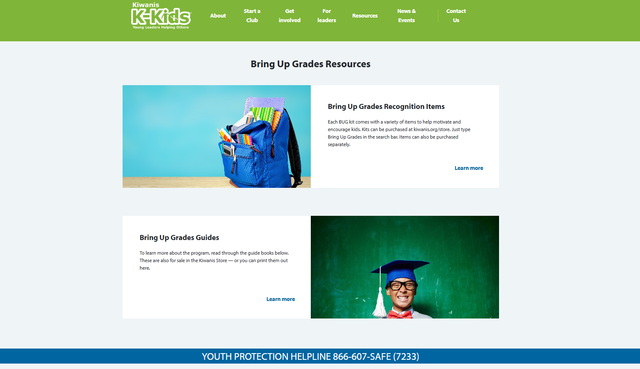
K-Kids.org/Bring-Up-Grades
Notes:
Find all the information needed to start a Bring Up Grades program online at www.K-Kids.org/Bring-Up-Grades.

Slide 24
Scroll to the bottom of the page
Notes:
Find all the information needed to start a program by visiting TerrificKids.org.

Slide 25
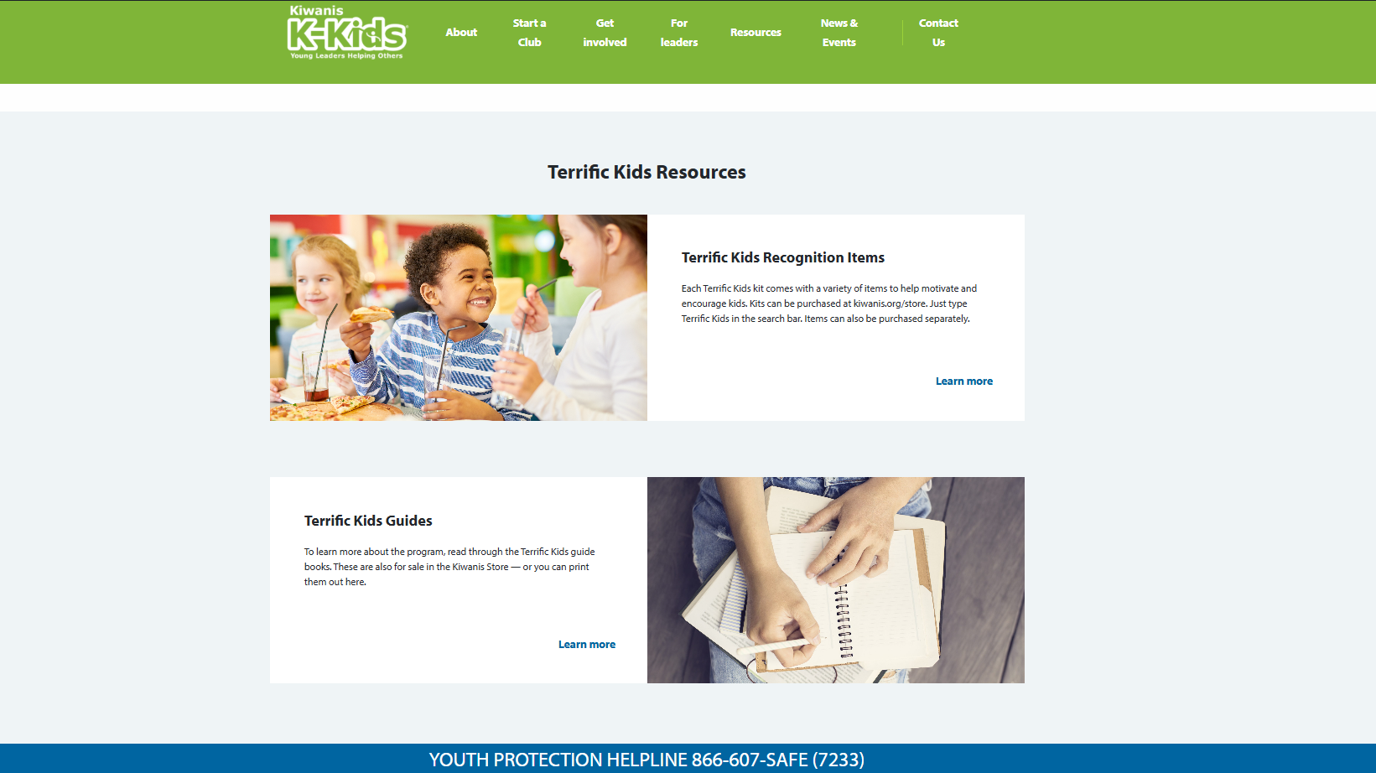
KiwanisKids.org/Terrific-Kids
Notes:
Find all the information needed to start a program by visiting www.K-Kids.org/Terrific-Kids.

Slide 26
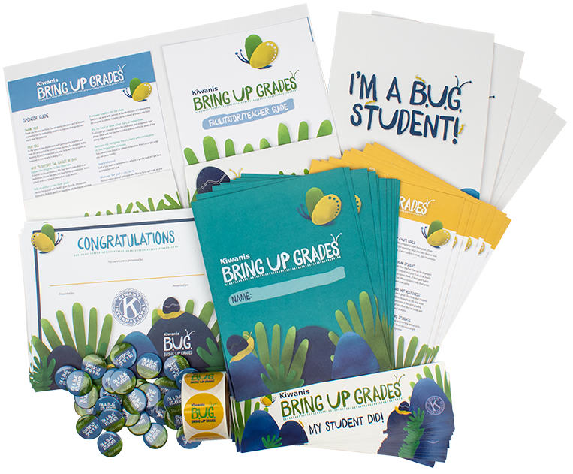
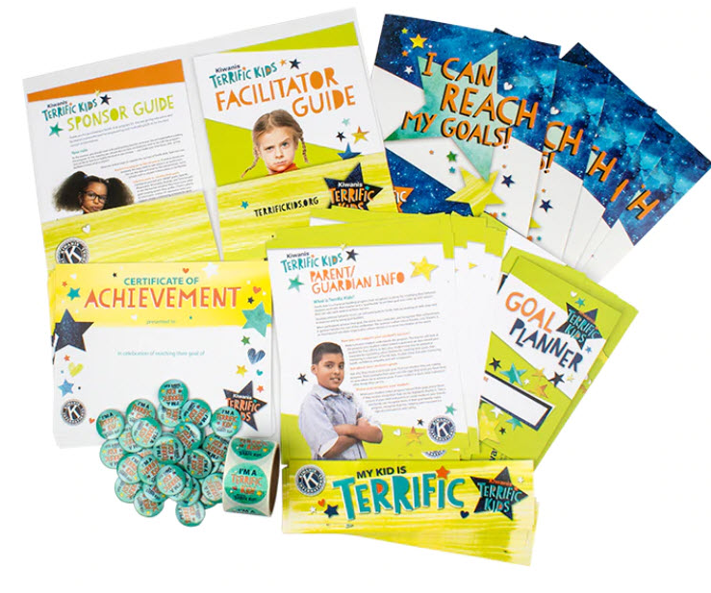
Purchase supplies
Visit: Store.Kiwanis.org/home.
Notes:
Purchase supplies for the class.
Sponsors can work with partners to handle the costs of implementing the program in schools. Supplies can be ordered at Kiwanis.org/store. There are guides to distribute to everyone involved. The following resources are available to distribute: Facilitator Guide, Sponsor Guide, Participant Guide, and Parent Guide.

Slide 27
Explain the program
Make sure students understand:
How recognition is achieved.
That supporting others in achieving their goals is a good thing.
Using SMART goals will help them succeed.
Everyone has strengths and weaknesses.
If goals aren’t achieved by the deadline, there’s an opportunity to regroup and try again.
Notes:
Explain the program to participants.
If several classes are involved, this may need to take place in an auditorium. Discuss the date and time for this presentation. Some schools wish to explain it themselves, so be flexible.
Tips: Make sure students understand how to achieve recognition. Highlight the fact that they are responsible for selecting their goals. Inform students that if they don’t reach their goal they’ll have an opportunity to reflect, regroup and try again.

Slide 28
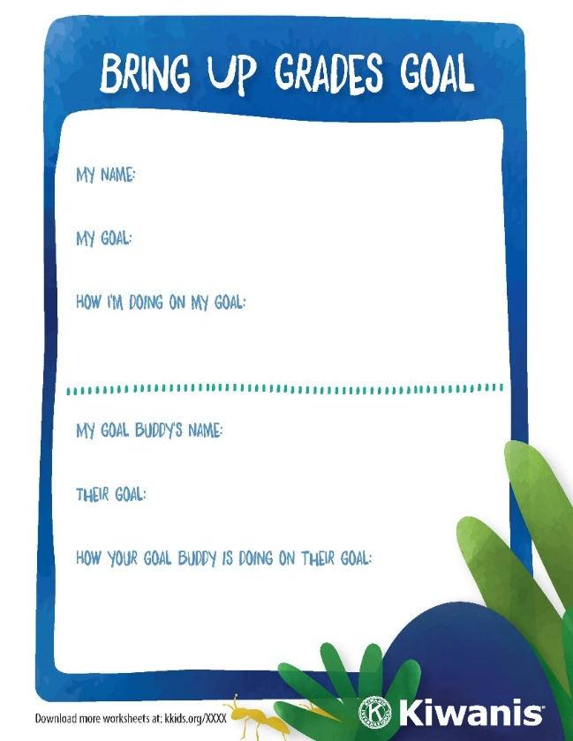
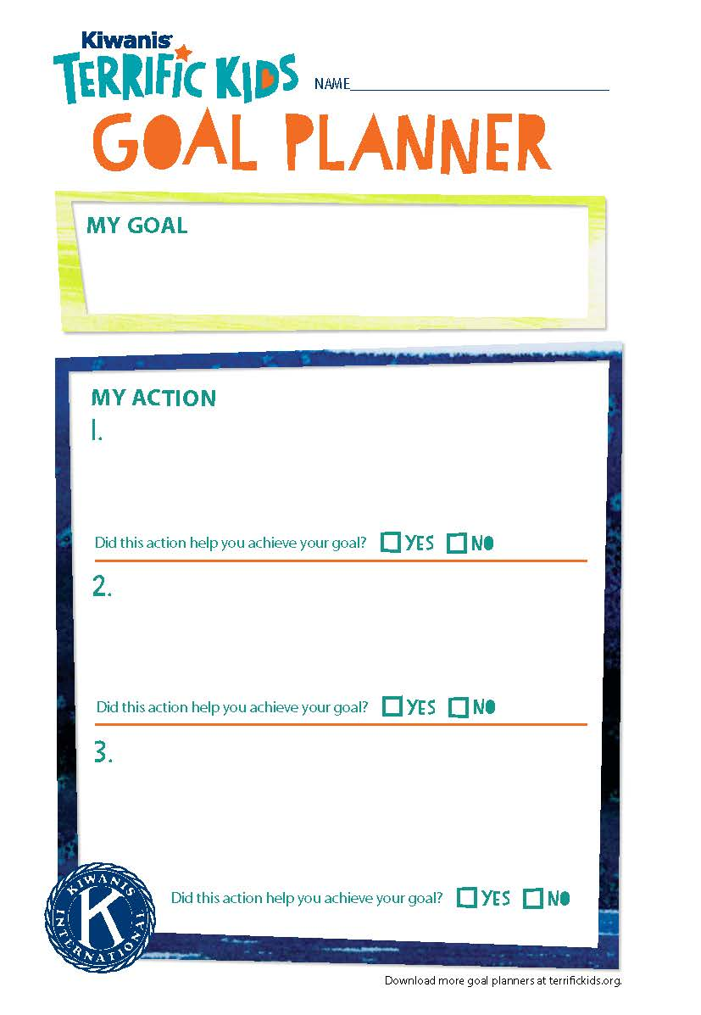
Help students select goals
SMART goals:
Specific
Measurable Attainable
Realistic
Time bound
Notes:
Help kids create their goals.
Goals will be set around improving grades in one or more subjects in the Bring Up Grades program. Goals established for Terrific Kids focus on changing behavior. A student might set a goal to spend 30 minutes a day reading, or to remember to ask for permission before taking things from the classroom. The teacher will be able to assist with behavior goals that will be helpful to establish.
Use the Goal Planner Guide included in the Bring Up Grades and Terrific Kids materials to assist with this task.
Also, review SMART goals (Specific, Measurable, Attainable, Realistic and Time bound) or ask the teacher whether they have some other goal guide they prefer to use. Remember, when working with students use the Goal Planner Guide. They can keep this guide and track their progress.

Slide 29
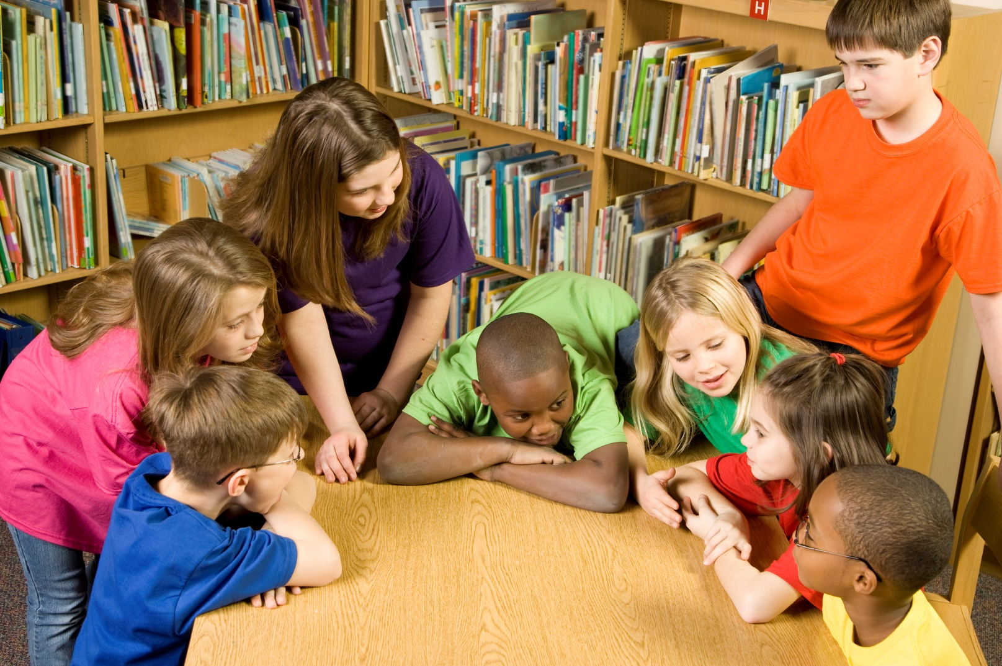
Help students succeed
Meet with students to review their goals.
Notes:
Meet with students to review their goals.
Teachers will want to keep track of each student’s goal progress. A great way to do this is to display student goals at the front of the room and encourage everyone to help one another in achieving their goals. The Bring Up Grades and Terrific Kids kits have Goal Planner Guides to use for this purpose.

Slide 30
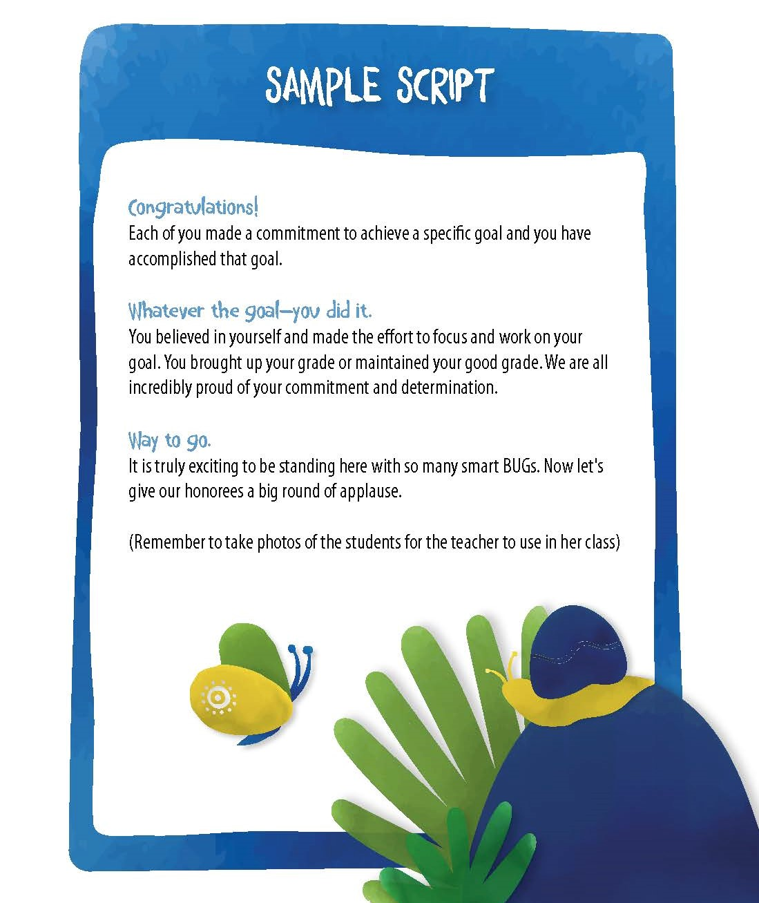
Recognize students
Visit store.Kiwanis.org/home to purchase BUG and Terrific Kids branded recognition items.
Notes:
Recognize recipients
Recognize students with certificates at the recognition ceremony. There are many recognition items available for purchase from the Kiwanis Family Store to honor those who have achieved their goals.
Visit Kiwanis.org/store and look for the Bring Up Grades and Terrific Kids drop down navigation. Click on the appropriate program and view all the merchandise. Order merchandise at least 6 weeks before the scheduled recognition event.
Use the sample script provided in the kit when presenting recognition.

Slide 31
Store.Kiwanis.org/home
Notes:
Recognize recipients
Recognize students with certificates at the recognition ceremony. There are many recognition items available for purchase from the Kiwanis Family Store to honor those who have achieved their goals.
Visit Kiwanis.org/store and look for the Bring Up Grades and Terrific Kids drop down navigation. Click on the appropriate program and view all the merchandise. Order merchandise at least 6 weeks before the scheduled recognition event.
Use the sample script provided in the kit when presenting recognition.

Slide 32
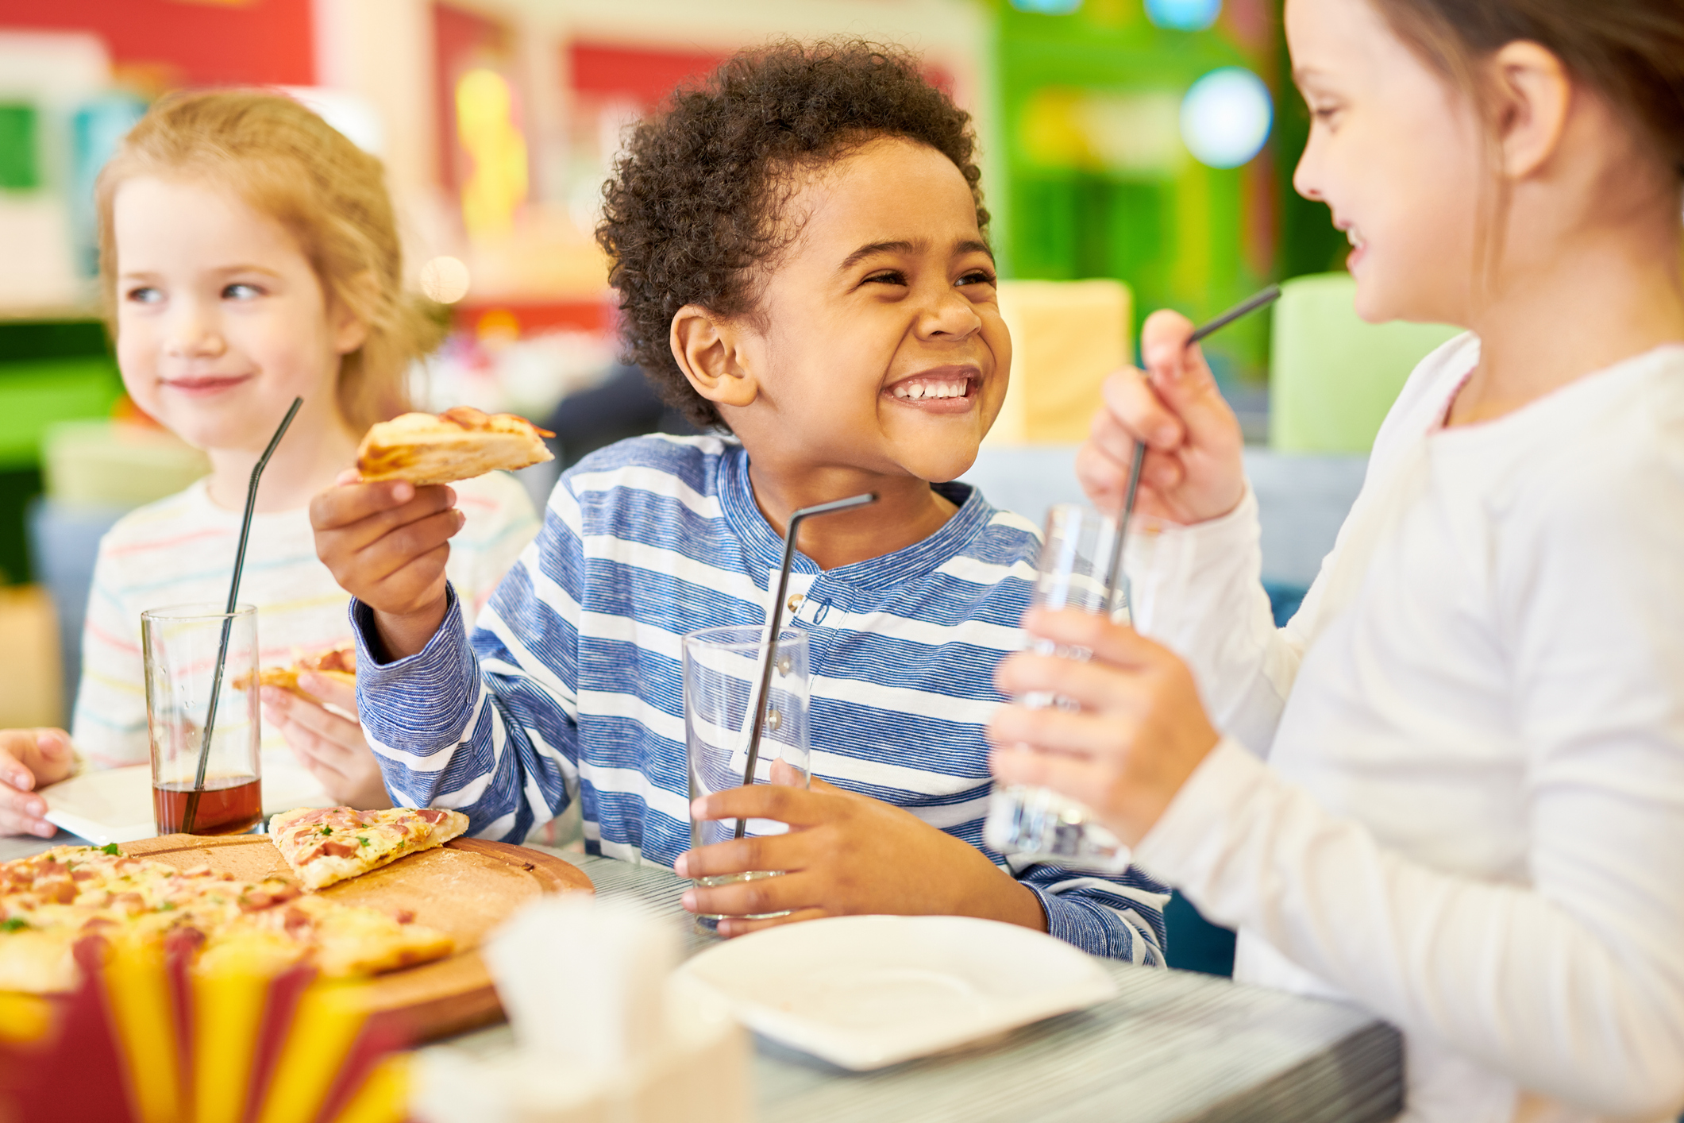
Celebrate success
Notes:
Celebrate!
A pizza party is a popular option for celebration and recognition. But always check with the teacher on school policies and to be aware of any allergy requirements.

Slide 33
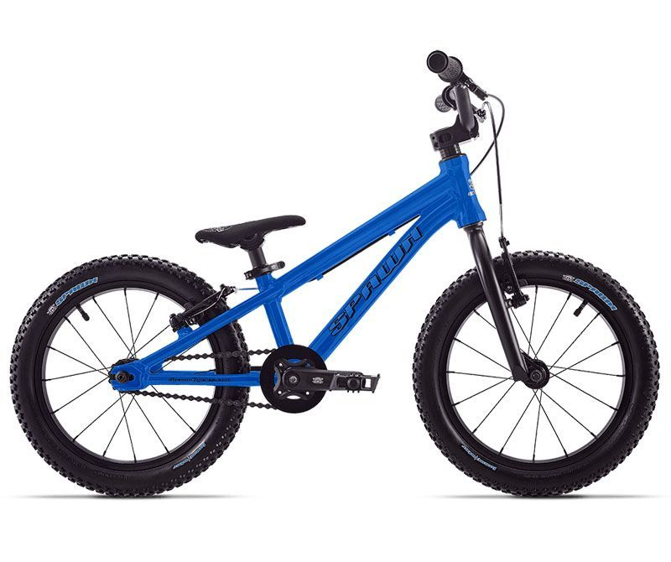
Motivate more students to participate
Enter BUG/Terrific Kid recipients in a biannual or quarterly prize drawing. Work with a local business sponsor to provide prizes like bicycles or electronics.
Notes:
A possible recognition idea your club might consider includes entering students who are recognized in a drawing for a larger prize to be awarded before the semester break or at the end of the school year. Make sure students know they’ll be entered in the drawing and display the prize in a prominent area to encourage involvement. Offering a prize like this also allows the Kiwanis club to partner with community businesses who are interested in working with local schools.

Slide 34
Notes:
Thank you!

