Slide 1

Club Advisor Check-in Chat
Monday, March 6, 2023

Slide 2

Introductions
Welcome
Awesome!

Slide 3

Awards & Recognition
Participating is easy and fun!
Awesome!

Slide 4




Plan ahead
Review Awards and Recognition Opportunities in Advisor Guide.
Learn more at – kkid.org.
Releases and forms are posted online at KKids.org/advisors and shared in the Advisor Guide.
Notes:
Keep all your information in an organized manor so you can use it the next year.
Use the scrapbook to motivate club members.
Organize photographs of club members and consent releases online in Google Docs where club members can gain access for use in creating other materials.
Saving information in a sharable place, is best, so that new club members can gain access when it’s time to start the contest entry process again the next year.

Slide 5
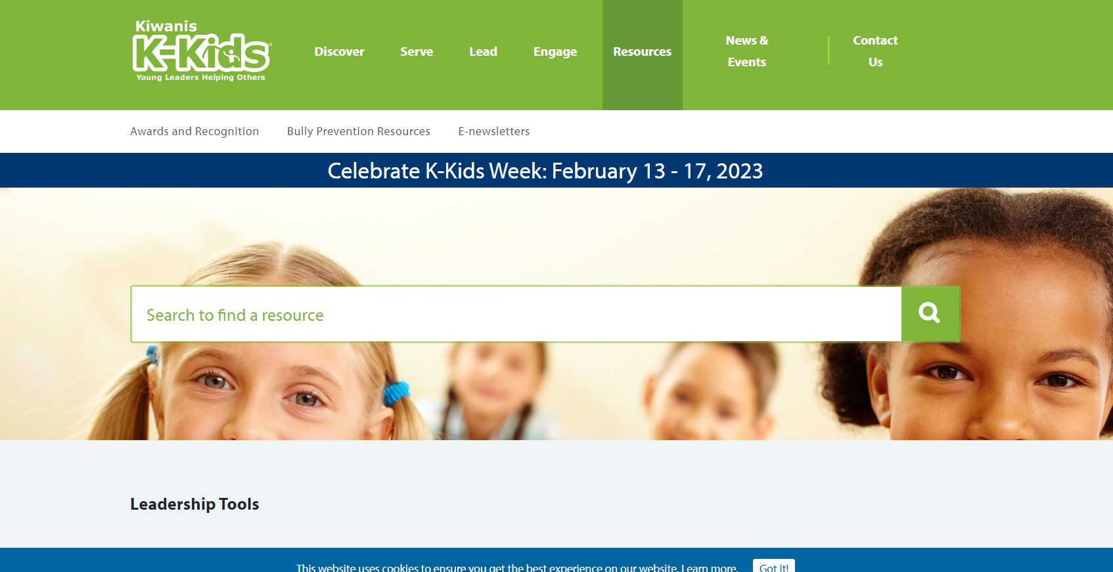
Award Information
K-Kids.org/AwardsandRecognition
Notes:
Look online to review award opportunities and share information with your K-Kids members. Visit kkids.org/AwardsandRecognition to learn more.

Slide 6
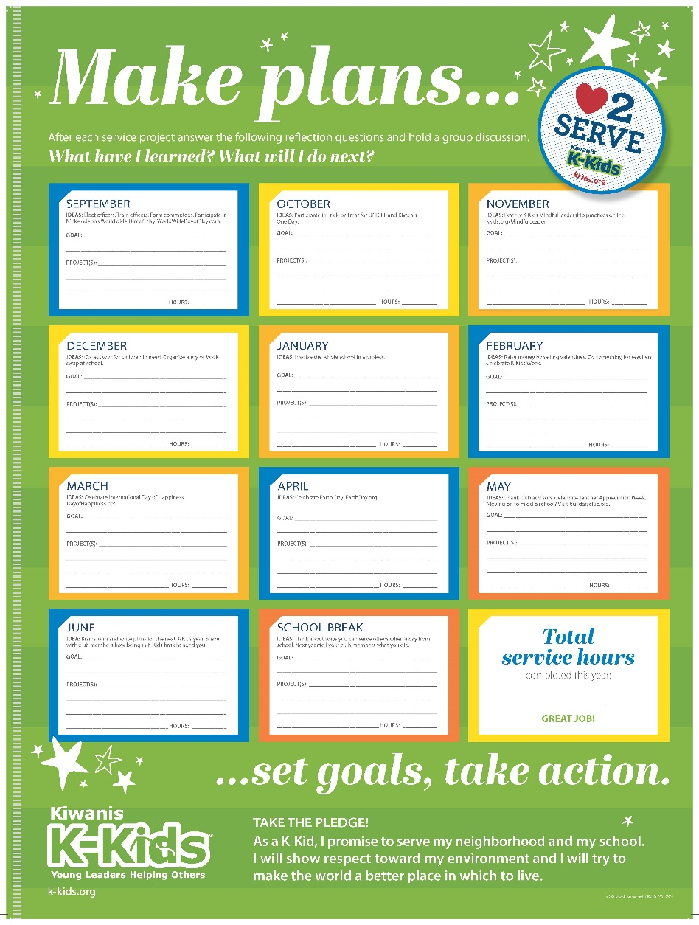
Planning
September
Review and share award opportunities with club members.
Form an Awards and Recognition Committee to track the club’s progress for attaining recognition.
October thru April
Receive updates from the Awards and Recognition Committee during club meetings.
May
Submit award entries online at Kkids.org.
Notes:
Be intentional about participating in contests. Track the amazing work your club members do in order to make the award entry process easy and fun. There are fun ways to do this that we’ll discuss as we move through the rest of the presentation.

Slide 7

What’s next
Make the award entry process easier by doing these things!
Notes:
Let’s review things that can be done to make the awards process easier.

Slide 8

Photo releases
Releases are posted on KKids.org/advisors
Notes:
Make sure to distribute consent releases at the beginning of the year, so that any photos you take of K-Kids club members can be included in award submission entries and in social media posts.
Photo consent releases can be found in the K-Kids Advisor Guide and online on at https://www.kiwaniskids.org/resources/advisor-guide/

Slide 9

Assign club reporters
Notes:
Assign club reporters at the beginning of the year. Ask students to work together to write about the happenings at each club activity and project. Start a shared Google document where information can be saved.

Slide 10

Assign photographers
Notes:
Assign club photographers at the beginning of the year so club members capture the club’s best moments of planning and conducting community service. Ask students to work together to determine what makes the best photograph and everyone will be tasked with following these best practices when taking photos.
Save photos in a shared Google file so that others in the club have easy access to these photos for use.

Slide 11

Award opportunities
Notes:
Let’s review award categories

Slide 12

Individuals
Distinguished Club Officer
Nomination criteria
General award information
Submit nominations by May 1, 2023
Notes:
Distinguished Club Officer
Do you know a club officer who deserves to be recognized for their outstanding contributions to your club? Nominate them for a Distinguished Club Officers award! Ask your club advisor to help you tell us why you think your club officer has gone above and beyond the call of service.
The nomination process is easy.
One person from the club can nominate a club officer, or it can be a group effort.
There is no limit to which club officers can be selected per district.
Any member, fellow club officer, club advisor or district administrator may nominate a club officer.
Club officers may not nominate themselves.
To enter, just complete and submit the following form by May 1. Then, share why you nominated your club officer on Facebook or Twitter and tag @KiwanisKids so everyone can see your club officer’s incredible efforts.
Recipients will be announced on K-Kids official social media channels and in the K-Kids monthly e-newsletter.

Slide 13
Award Information
Distinguished Club Officer
There is no limit to which club officers can be selected per district. Any member, fellow club officer, club advisor or district administrator may nominate a club officer. (Club officers may not nominate themselves.)
Names of award recipients are posted on the K-Kids website, announced in the K-Kids monthly e-newsletter, and shared on the official K-Kids Facebook and Twitter pages.
Nominating is easy! Just complete this online form by May 1. Then stay tuned to hear the announcement of winners during the month of May.
Read the Distinguished Club Officers award criteria before getting started to ensure your honoree is eligible for recognition.
Notes:
Award information
There is no limit to which club officers can be selected per district. Any member, fellow club officer, club advisor or district administrator may nominate a club officer. (Club officers may not nominate themselves.)
Names of award recipients are posted on the K-Kids website, announced in the K-Kids monthly e-newsletter, and shared on the official K-Kids Facebook and Twitter pages.
Nominating is easy! Just complete this online form by May 1. Then stay tuned to hear the announcement of winners during the month of May.
Read the Distinguished Club Officers award criteria before getting started to ensure your honoree is eligible for recognition.
Award criteria
Any K-Kids club officer in good standing in an active K-Kids club is eligible to participate.
Submissions must be completed through the K-Kids online Formstack submission form. Other methods of submission will not be considered.
Users can each submit only ONE entry for consideration.
Distinguished Club Officer nominations must be submitted by Monday, May 1. Submissions uploaded after this time will not be considered.
Distinguished Club Officer recipients will be posted on the website and announced via the official K-Kids monthly e-newsletter and on social media channels.
By submitting a nomination for Distinguished Club Officers, the honoree and everyone involved agrees to the use of the honoree’s name, voice, likeness and photo/video submission in any advertising or promotion without compensation.
Kiwanis International employees, their licensees, associates, affiliates, subsidiaries, exhibitors or their immediate family member and/or those living in the same household are not eligible.
By participating in this award nomination, entrants agree to be bound by the official award criteria.
Nominate: Distinguished Club Officer (Due May 1)

Slide 14

Individuals
Distinguished Club Advisor
Submit nominations by May 1, 2023
Notes:
Distinguished Club Advisor
Do you know a club advisor who deserves to be recognized for their outstanding contributions to your club? Nominate them for a Distinguished Advisors award and tell us why you think your club officer has gone above and beyond the call of service!
The nomination process is easy. Read the Distinguished Advisors award rules before getting started to ensure your entry is eligible to win.
One person from the club can nominate a club advisor, or it can be a group effort.
There is no limit to which club advisors that can be selected per district.
Any member, club officer, fellow club advisor, or district administrator may nominate a club advisor.
Club advisors may not nominate themselves.
To enter, just complete and submit the following form by May 1. Then, share why you nominated your club officer on Facebook or Twitter and tag @KiwanisKids so everyone can see your club advisor’s incredible efforts.
Winners will be announced no later than May 15, on K-Kids official social media channels and in the May monthly newsletter.

Slide 15
Award Information
Distinguished Club Advisor
There is no limit to which club advisors can be selected per district. Any member, club officer, fellow club advisor or district administrator may nominate a club advisor. (Club advisors may not nominate themselves.)
Names of award recipients will be posted on the K-Kids website, announced in the K-Kids monthly e-newsletter, and shared on the official K-Kids Facebook and Twitter pages.
Nominating is easy! Just complete this online form by May 1. Then stay tuned to hear the announcement of the recipients.
Read the Distinguished Advisors award criteria before submitting your nomination to ensure your honoree is eligible for recognition.
Notes:
Award information
There is no limit to which club advisors can be selected per district. Any member, club officer, fellow club advisor or district administrator may nominate a club advisor. (Club advisors may not nominate themselves.)
Names of award recipients will be posted on the K-Kids website, announced in the K-Kids monthly e-newsletter, and shared on the official K-Kids Facebook and Twitter pages.
Nominating is easy! Just complete this online form by May 1. Then stay tuned to hear the announcement of the recipients.
Read the Distinguished Advisors award criteria before submitting your nomination to ensure your honoree is eligible for recognition.
Award criteria
Any K-Kids club advisor in good standing in an active K-Kids club is eligible to participate.
Submissions must include content identified in the award criteria. Videos, photos and files about subjects other than what is posted in the rules are not eligible and will not be judged.
Submissions must be completed through the K-Kids submission form on Formstack. Other methods of submission will not be considered.
Users can each submit only ONE entry for consideration.
Distinguished Advisor nominations must be submitted by Monday, May 1. Submissions uploaded after this time will not be considered.
Distinguished Advisor recipients will be posted on the K-Kids website and announced via the official K-Kids monthly e-newsletter and on social media channels.
Those nominating a Distinguished Advisor, the honoree and everyone involved agrees to the use the honoree’s name, voice, likeness and photo/video submission in any advertising or promotion without compensation.
Kiwanis International employees, their licensees, associates, affiliates, subsidiaries, exhibitors or their immediate family member and/or those living in the same household are not eligible.
By participating in this award nomination, entrants agree to be bound by the award criteria.
Nominate: Distinguished Club Advisor (Due May 1)

Slide 16

Clubs
Annual Achievement Report
Reports may be submitted May 1 - June 10, 2023
Notes:
Award Criteria: Annual Achievement Report
K-Kids club members can complete the Annual Achievement Report with the help of their faculty advisor. This self-scoring report shares activities the club needs to conduct to receive recognition. In fact, think of this report as a guide to what your K-Kids club should achieve every year.
Reviewing the Annual Achievement Report at the beginning of the year ensures that the club accomplishes all the requirements to achieve recognition.
Reports are due June 10 and depending on the number of points earned, the club will be honored as a Distinguished Club or an Honor Club.
Faculty advisors of qualifying clubs will receive an email with confirmation of recognition and a link to download a digital badge to display on the school/club website, as well as social media graphics to promote the club’s achievement online.
Point totals: 15 points or more = Distinguished Club, 10 – 14 points = Honor Club

Slide 17
Award Information
Annual Achievement Report
Your club can be recognized as either a Distinguished Club or an Honor Club based on the number of points it earns from responses to the report’s questions.
Earn 15 points or more → Distinguished Club
Earn 10 – 14 points → Honor Club

Slide 18
Award Information
Annual Achievement Report
Did your club host an installation ceremony (virtual or live) at the start of the club year?
Did your club visit kkids.org/IDEA and use the resources provided?
Did your club elect officers the previous year or within the first three months of the current school year?
Did club officers receive training (virtual or live)?
Did the club secretary keep minutes for club meetings?
Did the club establish one or more committees?

Slide 19
Award Information
Annual Achievement Report
Did the club organize and conduct at least one school-wide (virtual or live) service project during the year?
Did the club organize and conduct a (virtual or live) teacher/staff appreciation event during the year
Did your club participate in Trick-or-Treat for UNICEF? Visit unicefusa.org/trick-or-treat for more information
Did your club submit a news story to your Kiwanis club or district?
Did your club share about K-Kids projects through school social media feeds?
Did your club celebrate K-Kids Week (The 3rd full week of February)?

Slide 20
Award Information
Annual Achievement Report
Were club parents invited to attend a (virtual or live) meeting, projects or events?
Did club members participate in (virtual or live) meetings or events with a Builders Club (middle school), Key Club (high school) or Kiwanis Club?
Did the club members conduct eight or more (virtual or live) club meetings?
Did club officers attend and/or present at least one (virtual or live) Kiwanis club meeting?
Did club members use their member handbooks?
Did the club have 15 or more members by April 1?

Slide 21
Award Information
Annual Achievement Report
Did your club graduates learn about Builders Club at the end of the year?
Did you (or your fellow advisor) complete at least 4 K-Kid monthly reports in the Kiwanis Online Reporting System? Visit kkids.org/monthly reports for more information.

Slide 22

Submission Process
KKids.org/AwardsandRecognition
Notes:
All award entries must be submitted online using the correct form. Visit https://www.kiwaniskids.org/awards-and-recognition/ for more information.

Slide 23
Recognition
How clubs are recognized
Digital award recognition
Award recognition is provided digitally. Presenter and recognition letters, certificates and electronic badges are all posted online for easy download.
The option of downloading and emailing recognition, printing and mailing a hard copy, or sharing the link and allowing the recipient(s) to download recognition is provided.
Award recipients are posted on the K-Kids website and shared in the K-Kids Advisor monthly e-newsletter and through K-Kids social media.
Notes:
Digital award recognition
Award recognition is provided digitally. Presenter and recognition letters, certificates and electronic badges are all posted online for easy download.
The option of downloading and emailing recognition, printing and mailing a hard copy, or sharing the link and allowing the recipient(s) to download recognition is provided.
Award recipients are posted on the K-Kids website and shared in the K-Kids Advisor monthly e-newsletter and through K-Kids social media.

Slide 24

Promote the club
Notes:
Use what you’ve created this past year to promote the club. Share information about your club and the awards received on social media. Remember to notify Kiwanis by including #Kkids.org on any social media posts.

Slide 25

Any
questions?

Slide 26
Your thoughts?
Let’s review contests we’ve had in the past.
Digital member recruitment poster
Digital scrapbooks
Year-in-Review (club experience) video
Single Service Award
Please share brief thoughts about bringing contest opportunities back.

Slide 27
Let’s chat
What’s working this year for your club?

Slide 28

Thank you!
Luana Nisan
SLP Manager
lnissan@kiwanis.org
Lisa J. Pyron
SLP Development Specialist
lpyron@kiwanis.org
Notes:
Kiwanis staff are always available to help. Here are our email addresses. Also, remember for awards information, visit the K-Kids website at https://www.kiwaniskids.org/awards-and-recognition/

