Slide 1

Kiwanis K-Kids
Young leaders helping others!
Notes:
Introduce yourself to the group to which you are presenting.

Slide 2

What is K-Kids?
Notes:
What is K-Kids?

Slide 3


K-Kids
Elementary/Primary School
Ages 6 – 12
kkids.org
A student-led, community service club for elementary-age students.
More than 32,000 members worldwide.
Notes:
Read the statistics from the slide.

Slide 4
Frequently Asked Questions
How many members are needed to start a club?
Its's suggested that the club start with at least 15 members.
When and how often should a club meet?
Most clubs meet during the lunch hour, during recess, before or after school. Club meetings last ½ hour to 45 minutes and clubs meet every other week, or monthly.
What’s the club structure
Club members elect officers (President, Vice President, Secretary & Treasurer)and establish committees. The K-Kids Bylaws offer suggested guidelines for running the club.
Visit KiwanisKids.org/FAQ to find the answer to more fun questions.
Notes:
Read the statistics from the slide.

Slide 5
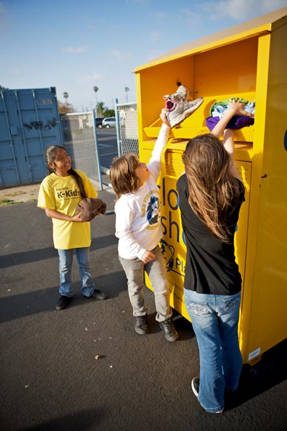
K-Kids teaches members the value of helping others through participation in community service and club activities.
Notes:
Where young leaders learn to help others
In ways large and small, K-Kids change the world around them and, in the process, transform themselves. Students lead the club, plan activities, participate in community service projects, celebrate their successes and develop empathy, self-confidence and compassion along the way. Through service to others they begin to understand the impact they can have on their school, their community and their world.

Slide 6
K-Kids Core Values
Character building
The ability to do the right thing, even when it might be the unpopular choice.
Leadership
The ability to listen, communicate, serve and guide others.
Inclusiveness
Accepting and welcoming the differences in others.
Caring
The act of being concerned about or interested in another person or situation.
Notes:
Read the Core Values from the slide.

Slide 7
K-Kids Pledge
As a K-Kid, I promise to serve my neighborhood and my school.
I will show respect toward my environment, and I will try to make the world a better place in which to live.
Notes:
Read the K-Kids pledge from the slide.

Slide 8

How do K-Kids help the school & community?
Notes:
How do K-Kids help the school and community? Let’s review service conducted by actual K-Kids clubs.

Slide 9
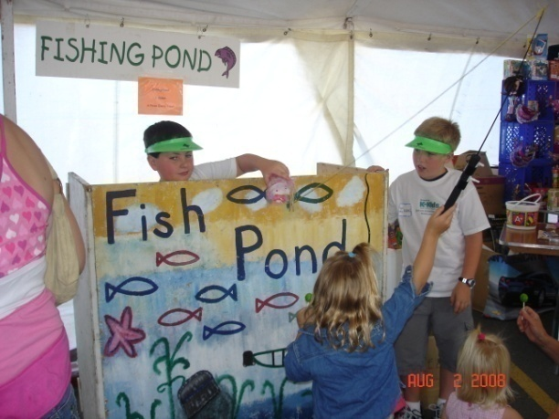
Service to School
Helping at the school fair.
Notes:
Service to school.
This K-Kids club created a game for the school fair and guided younger students as they stopped by to play their Fish Pond gaem.

Slide 10
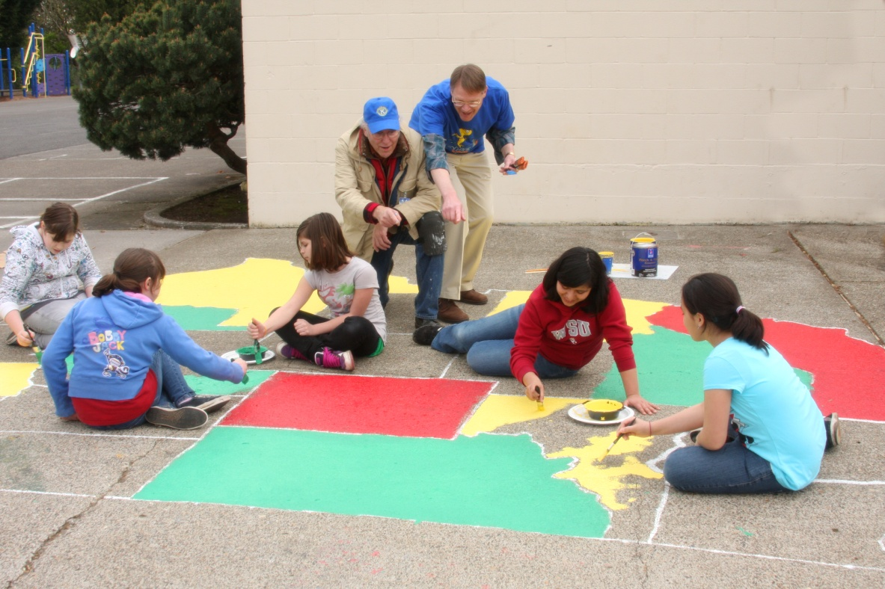
Painting the school playground.
Notes:
This K-Kids club spruced up the school’s playground by painting a map of the United States on the groud.

Slide 11
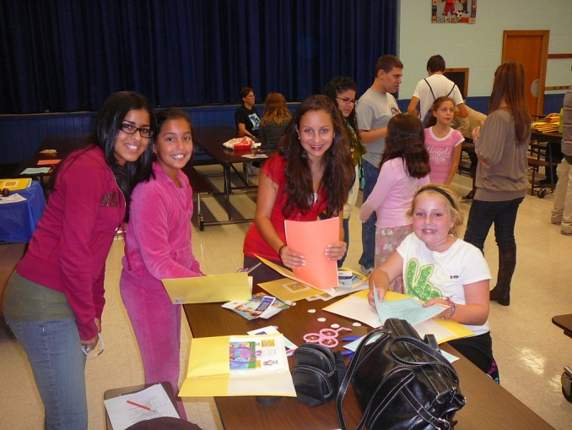
K-Kids to Community
Making greeting cards for veterans.
Notes:
This K-Kids club gathered to create greeting cards that were mailed to American veterans in their community.

Slide 12
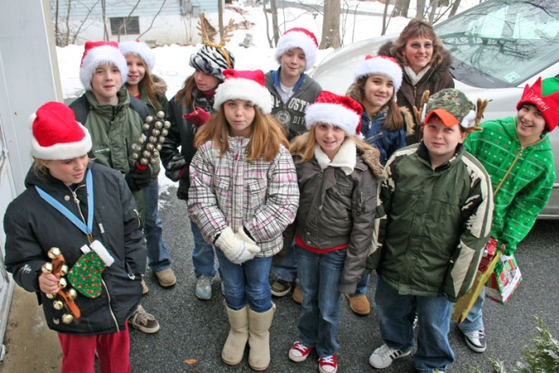
Providing gifts during the holidays.
Notes:
This club raised funds and provide gifts for families in need during the holidays.

Slide 13
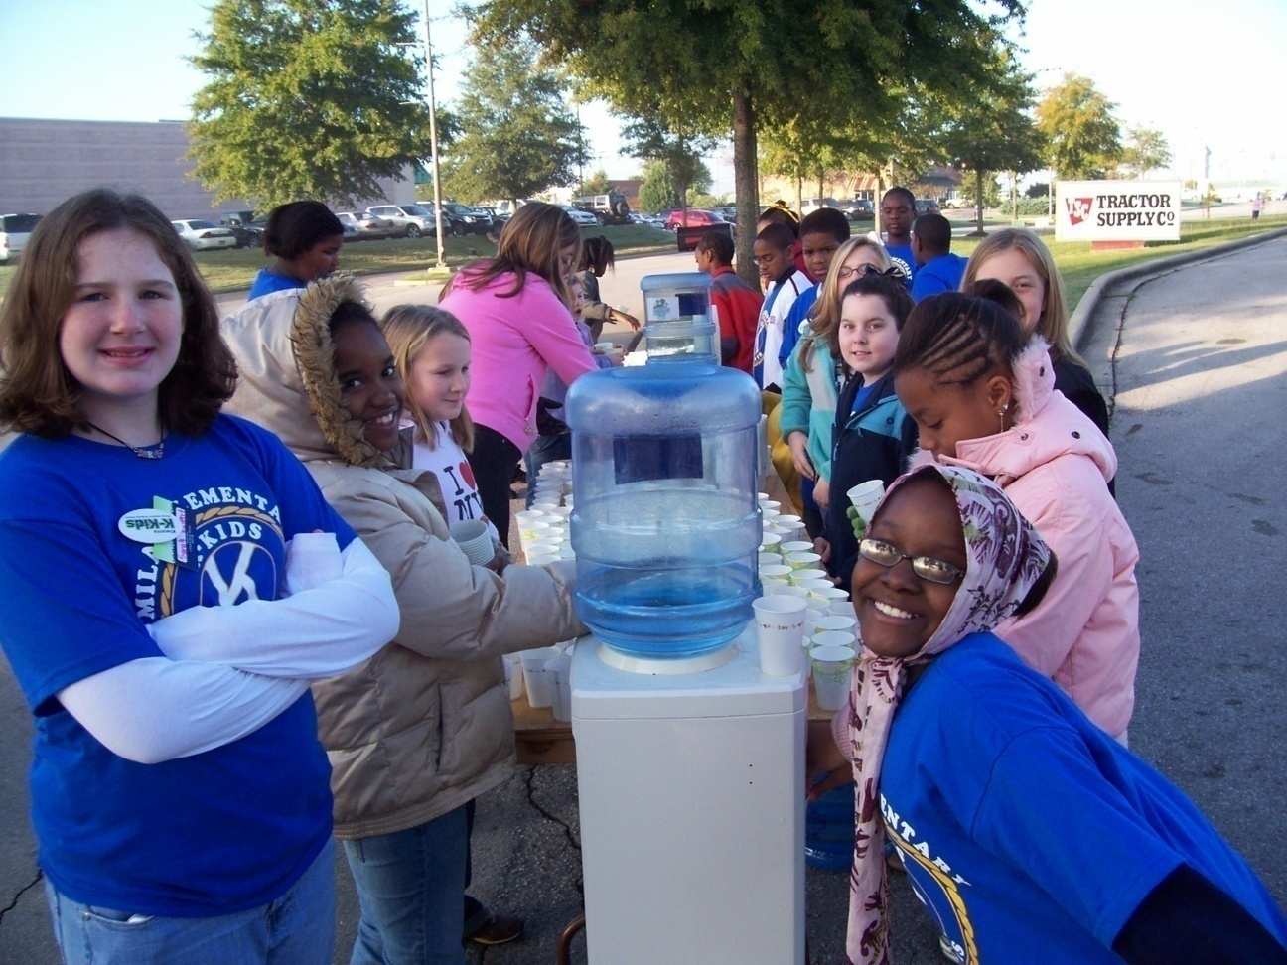
Providing water during a 10-K run.
Notes:
This K-Kids club manned a water station during a 10-K run in which runners were raising awareness cancer.

Slide 14

Involvement in
K-Kids helps students and their communities thrive!

Slide 15

K-Kids Club Support
How does Kiwanis support K-Kids?
Notes:
Now that you know what K-Kids club do, lets learn how Kiwanis supports K-Kids advisors working with K-Kids clubs.

Slide 16

Kiwanis International
Dedicated staff develop K-Kids programming.
Monthly advisor
e-newsletters.
Website resources.
Youth Protection training and background checks for Kiwanis volunteers & club advisors.
Data collection to improve programs.
Liability insurance coverage for clubs.
Advisor training.
Creation of annual K-Kids program kit with advisor and member materials.
Notes:
Kiwanis International supports K-Kids by doing the following:
Dedicated K-Kids staff develop K-Kids programming.
The K-Kids website offers current resources.
Online advisor training is offered each year.
Online service events are provided for members.
Monthly advisor e-newsletter.
Provides K-Kids program kit to clubs with resources.

Slide 17

Kiwanis District Administrator
Connects K-Kids with other Kiwanis family clubs in the district.
Relays information from Kiwanis International.
Provides advisor training and resources for clubs in the district.
Provides support to clubs without Kiwanis sponsors.
Builds new K-Kids clubs within the district.
Notes:
The Kiwanis District Administrator is the Kiwanis volunteer who provides support to K-Kids clubs within a specific state or Kiwanis district.
The administrator does the following:
Connects K-Kids with other Kiwanis family clubs in the district.
Relays information from Kiwanis International.
Provides advisor training and resources for clubs in the district.
Provides support to clubs without Kiwanis sponsors.
Builds new K-Kids clubs within the district.

Slide 18

Kiwanis Club
Sponsors the K-Kids club and provides financial support.
Provides a K-Kids Kiwanis advisor.
Assists with service projects and fundraisers.
Supports the host school/organization as needed.
Provides K-Kids with additional service opportunities.
Notes:
The Kiwanis club sponsors K-Kids. The Kiwanis club offers the following support:
Provides financial support.
Provides a K-Kids Kiwanis advisor.
Assists with service projects and fundraisers.
Supports the host school/organization as needed.
Provides K-Kids with additional service opportunities.

Slide 19

Kiwanis Advisor
Attends K-Kids club activities and meetings.
Assists with K-Kids service and fundraising projects.
Serves as the liaison between the K-Kids club and Kiwanis club.
Provides K-Kids member, officer and advisor training.
Assists the K-Kids faculty advisor as needed.
Notes:
A volunteer from the Kiwanis club offers to serve as Kiwanis advisor to the K-Kids club. This is how the Kiwanis advisor supports the K-Kids club.
Attends club activities and meetings.
Assists with K-Kids service and fundraising projects.
Serves as the liaison between the K-Kids club and Kiwanis club.
Provides K-Kids member, officer and advisor training.
Assists the K-Kids faculty advisor as needed.

Slide 20

Kiwanis Family
THE KIWANIS FAMILY ROCKS!
Notes:
K-Kids have even more support and service opportunities when teaming up with other Kiwanis family clubs. These include service clubs for middle school students, high school students and college students.
K-Kids is part of a family of clubs which includes youth clubs for every age group:
Builders Club for middle school students
Key Club for high school students
Circle K of college students
Kiwanis for adults
K-Kids members can continue to grow as leaders and participate in community service as they get older by continuing membership in the Kiwanis family.

Slide 21
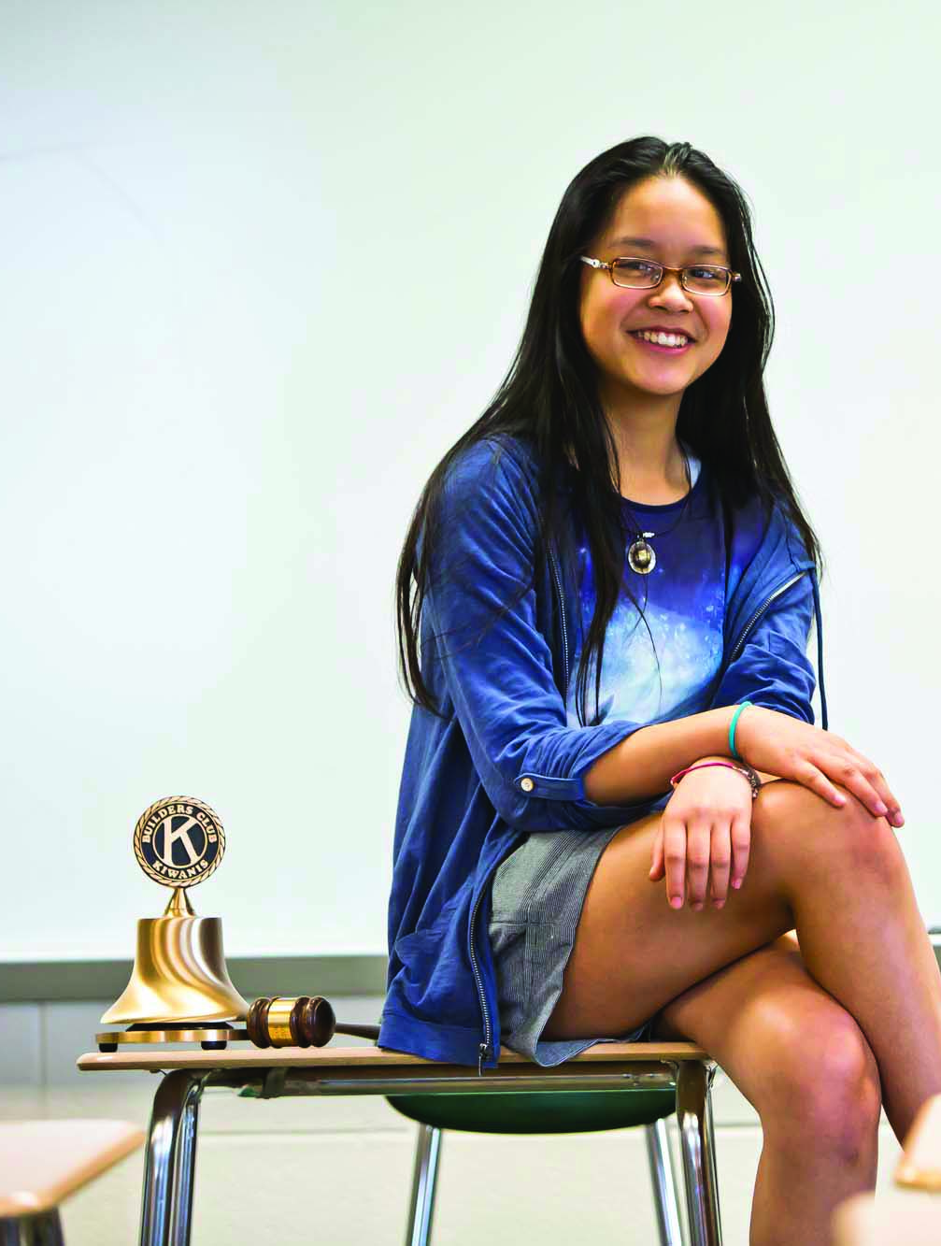

Graduating K-Kids
I learned so much as a K-Kids member. Now I’m using my leadership skills in Builders Club!
Middle/Junior High School
Ages 12 – 15
buildersclub.org
A student-led, community service club for junior high or middle school students.
More than 1,600 clubs in 18 nations.
Notes:
Graduation K-Kids can move on to Builders Club!
Building self-esteem at a pivotal age
Builders Club members are discovering who they want to become. Builders Club focuses all their raw potential into service for others – empowering them to be themselves, work together, make plans, set goals and take action. As they participate in club activities and events, students develop important social and emotional skills that help them make smarter decisions and avoid risky behavior.

Slide 22

Club Resources
Notes:
Now let’s review the resources a faculty advisor will have in order to help guide students in running the club.

Slide 23
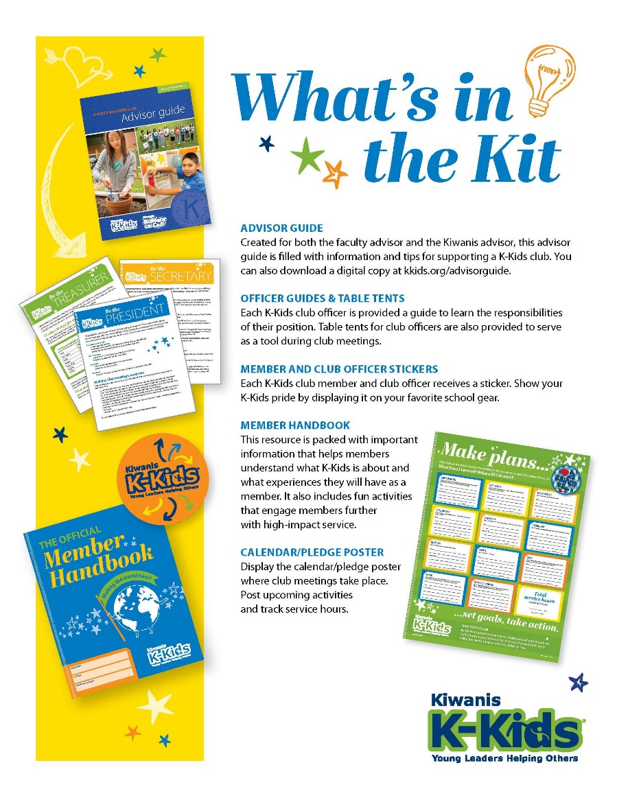
K-Kids program kit
K-Kids advisors
receive a
program kit each year with advisor and member resources.
Notes:
Support to advisors
An international resource is the Kiwanis International Office, located in Indianapolis, Indiana. Staff members produce literature and publications, create online advisor education, manage social media for the Kiwanis family, and more.
One key resource is the K-Kids is the program kit provided each year to assist club advisors in guiding club members through the year.
Items included in the program kit are shared here and include: Advisor guide, IDEA toolkit for officers, Officer guides, Officer and member pins or buttons, Member handbooks, pledge poster, and contest flier.

Slide 24

Advisor Guide
Kkids.org/advisors
Advisor Tools
Working with members
Serve
Lead
Engage
Officer training
Policies
Kiwanis Family
Notes:
The advisor guide includes helpful materials for guiding the club.
Sample Bylaws – explaining club structure
Sample Meeting agendas – to help guide club members
Club officer guides
A suggested calendar of things to do.
Information about how to conduct service projects and more.

Slide 25
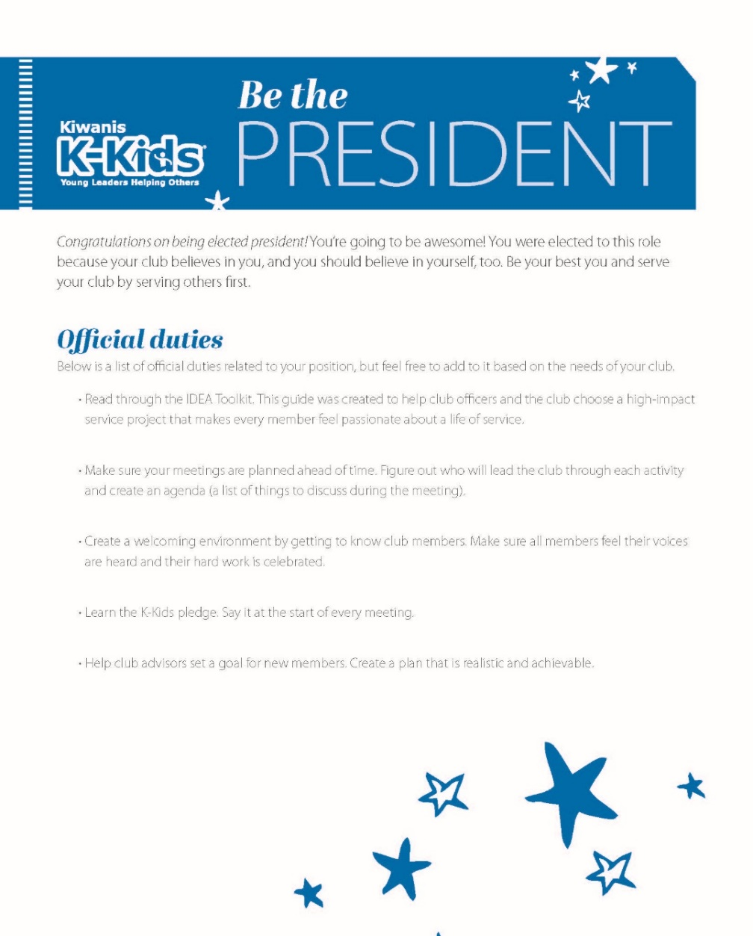
Officer Guides
Kkids.org/advisors
Officer guides help club officers lead the way.
Notes:
The officer guides include worksheets officers can use to complete their duties.

Slide 26
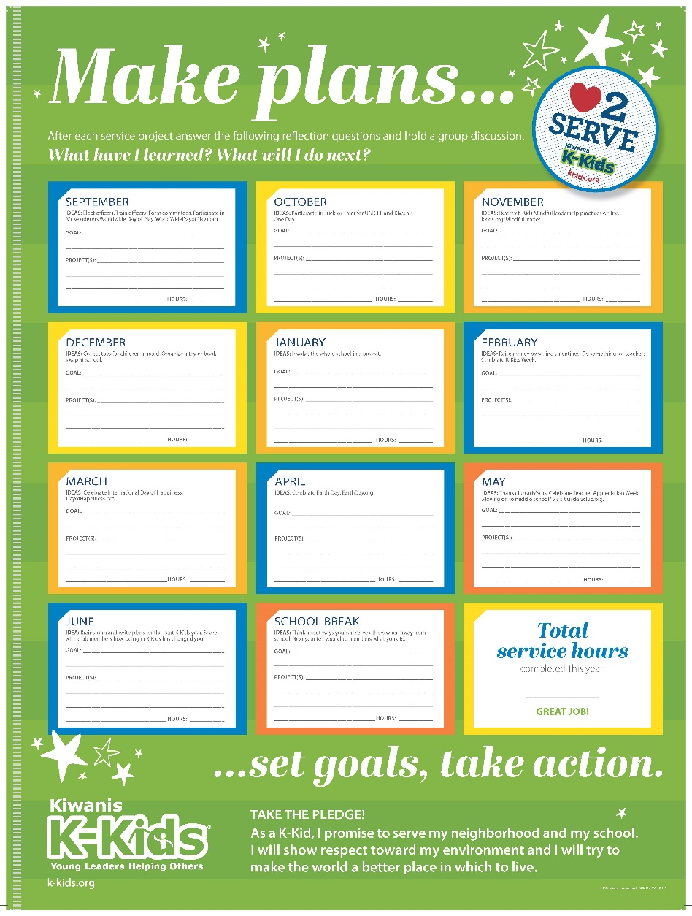
Calendar
Provided in program kit
Make plans and set goals with the K-Kids calendar poster.
Notes:
A poster with suggested service ideas will help the club tract their service

Slide 27

Advisor E-newsletters
Online at Kkids.org/advisors
Club advisors receive a K-Kids Advisor e-newsletter at the end of each month.
Sharing service conducted with Kiwanis International ensures your club will be highlighted in an e-newsletter.
Notes:
Advisors are encouraged to read the monthly e-newsletter with helpful resources. Club profiles are also highlighted so advisors can see what other clubs are doing.

Slide 28

Member Handbook
K-Kids.org/advisors
About K-Kids
Meeting Agendas
Calendar
Training Leadership
Serve/Lead/Engage
The Kiwanis Family
Notes:
Where development has no disability
Aktion Club is the one and only service club for adults with disabilities. Clubs are formed at or with various organizations that support individuals with disabilities, as well as other community programs. These caring adults develop confidence and character as they take on leadership roles in their clubs and direct service projects. Members gain a sense of purpose and personal satisfaction as they serve their communities, help others and discover their own talents.

Slide 29

IDEA Toolkit
Kkids.org/IDEA
Identify the need
Develop the passion
Execute the project
Advance the impact
Notes:
The IDEA toolkit is posted online for easy access. The entire toolkit or separate activities can be downloaded for use. It’s written specifically for club officers, the toolkit guides members through planning and executing a high-impact service project of their choosing from beginning to end. Each step contains instructions, handouts and tools for club officers. It’s also available online at kkids.org/idea and buildersclub.org/idea.
Identify the Need
Develop the Passion
Execute the Project
Advance the Impact

Slide 30
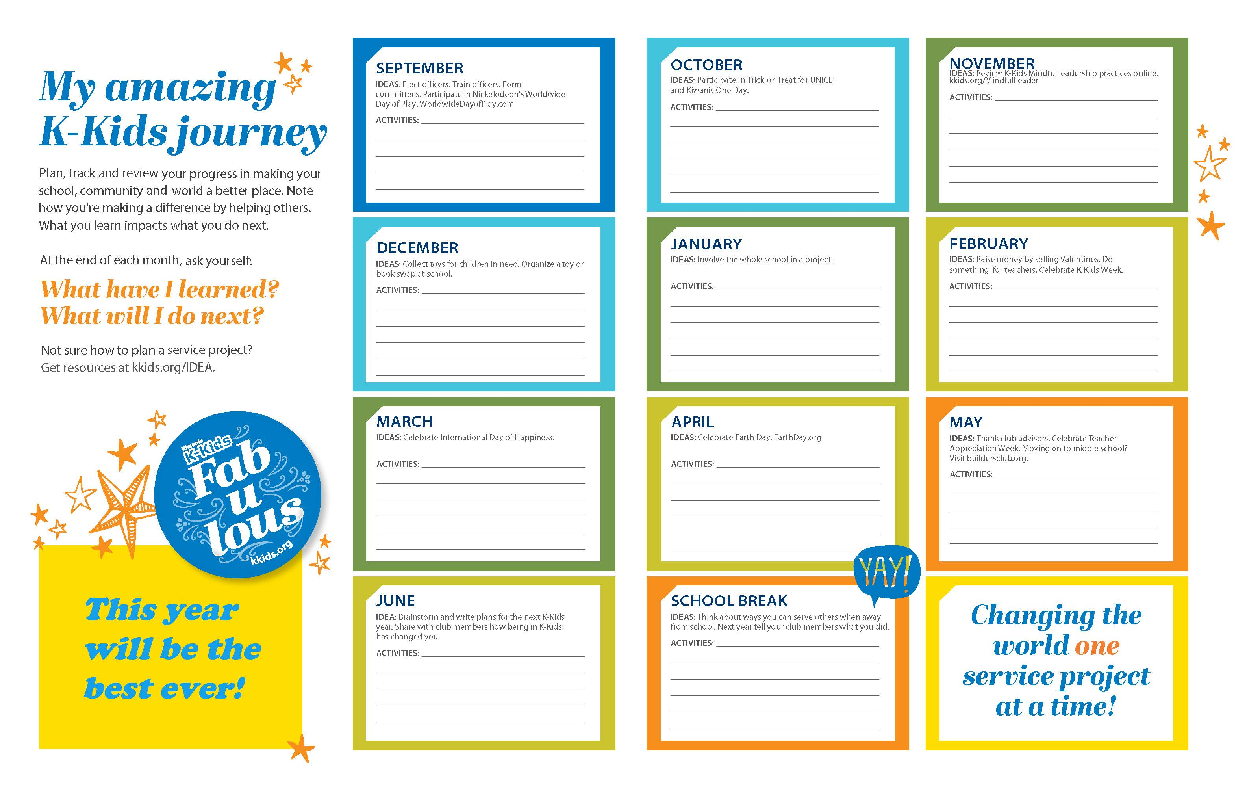
Member Calendar
Kkids.org/advisors
Notes:
A Member calendar is available online for club members to download and use to track the service they complete during the year.

Slide 31
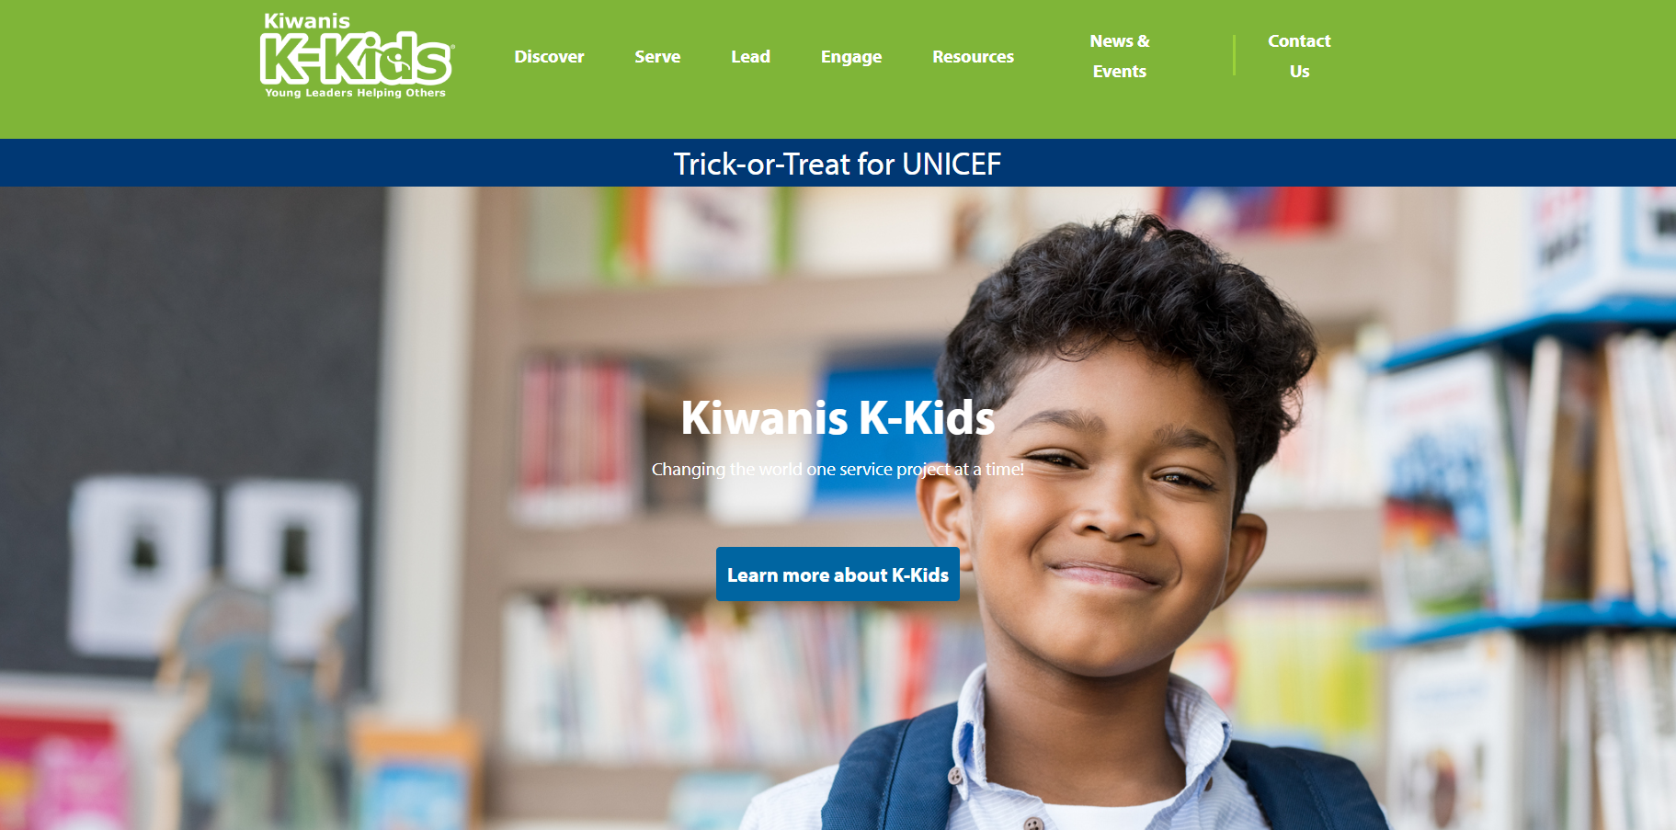
Website Resources
Visit: Kkids.org
Notes:
K-Kids resources are always a click away. Visit Kkids.org to find needed information. Everything needed to run the club can be downloaded from the website.

Slide 32
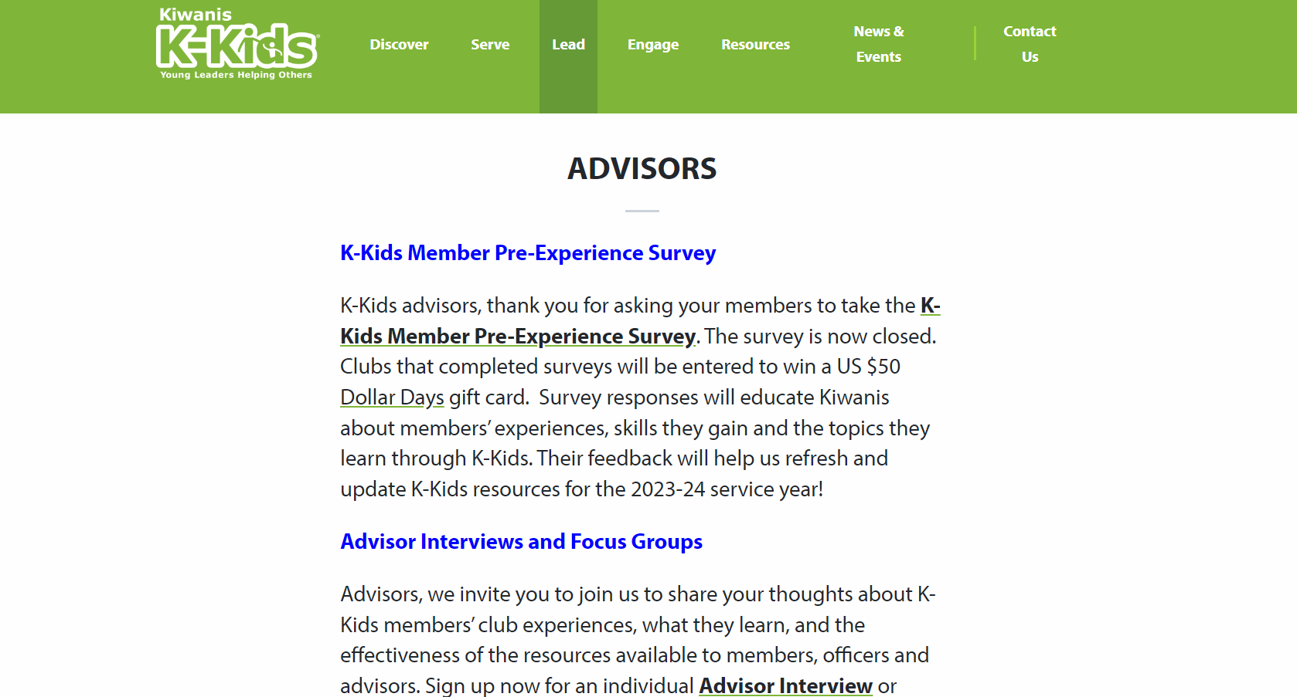
K-Kids Advisor Page
Kkids.org/advisors
Notes:
The Advisor page of the website is a one stop shop for club advisors. Links to all needed resources can be found on this page. The Advisor page is located under the Lead navigation.

Slide 33
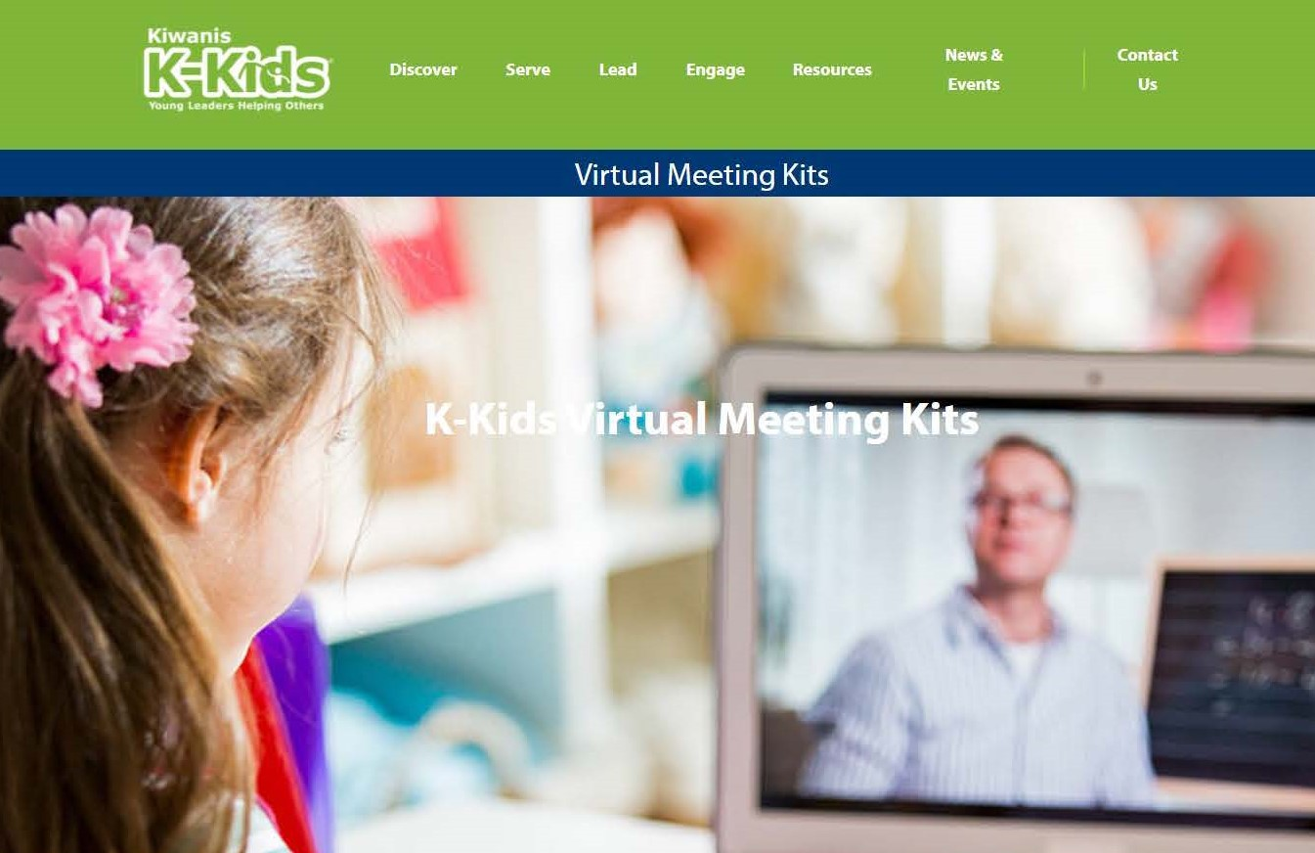
Meeting Kits
Notes:
Virtual meeting kits are available on the website. They can be used to lead virtual meetings or in person meetings. These kits include the following.
Activities and agendas for in-person or digital meetings
All new resources and worksheets
Topics include:
Back to School
Community Needs
Civic Engagement
Anti-Bullying | Culture of Care
Hunger & Food Insecurity
Thankfulness & Gratitude
Happy New Year of Service
Mental Health Awareness
Global Health Challenges

Slide 34




Virtual Key Leader
Kiwanis.org/VirtualKeyLeader
Club advisors can enroll in Kiwanis’ free online leadership training course. Modify and integrate leadership concepts for
K-Kids members.
Promotional/
Marketing
Class/
Meeting
Independent
Study
Family/Community
Activity
Notes:
VKL is a free, interactive, PDF workbook designed for students (8th grade and up) as well as adults. It includes videos, reflection and discussion topics, and offers a new perspective on some traditional Key Leader activities like the personality test.
The workbook is designed to be self-facilitated. Six “tracks” cover the topics of Service Leadership and the Five Key Leader Principles: Integrity, Growth, Respect, Community, and Excellence, and there are three activities in each track. The activities make for great meeting, classroom, or family activities to help teens discuss their values, goals, and role in the local community.
It also serves as a great primer for in-person Key Leader programs or a re-fresher on the topic for Student Facilitators at upcoming programs. Some districts are organizing virtual events to compliment or promote their in-person Key Leader events. (Nebraska, Ohio)
Free, Interactive, PDF Workbook
Self-led, Group, and/or Family Activities
Primer for in-person Key Leader and Service Leadership
Ages 13 & Up
K-Kids advisors can take this free leadership course and utilize strategies shared when working with K-Kids members.

Slide 35

Interested in starting a club?
Notes:
Interested in starting a K-Kids club?

Slide 36
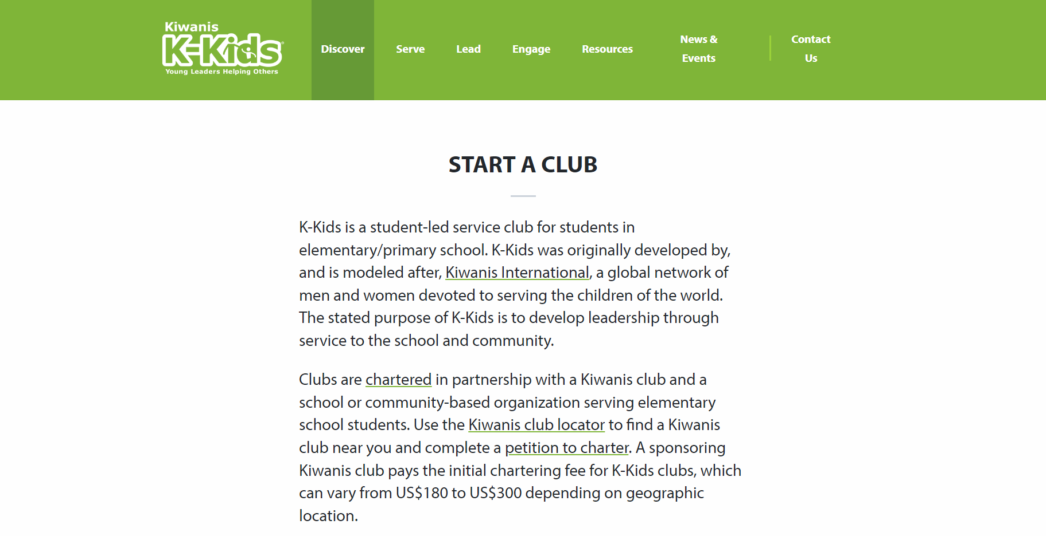
Visit KiwanisKids.org/Start-a-club
Notes:
Visit KiwanisKids.org/start-a-club to get started.

Slide 37

“Never doubt the power of a small group of people to change the world. Indeed, it’s the only thing that every has.
- Margaret Mead
Thank you!
Notes:
Thank you.

