Slide 1
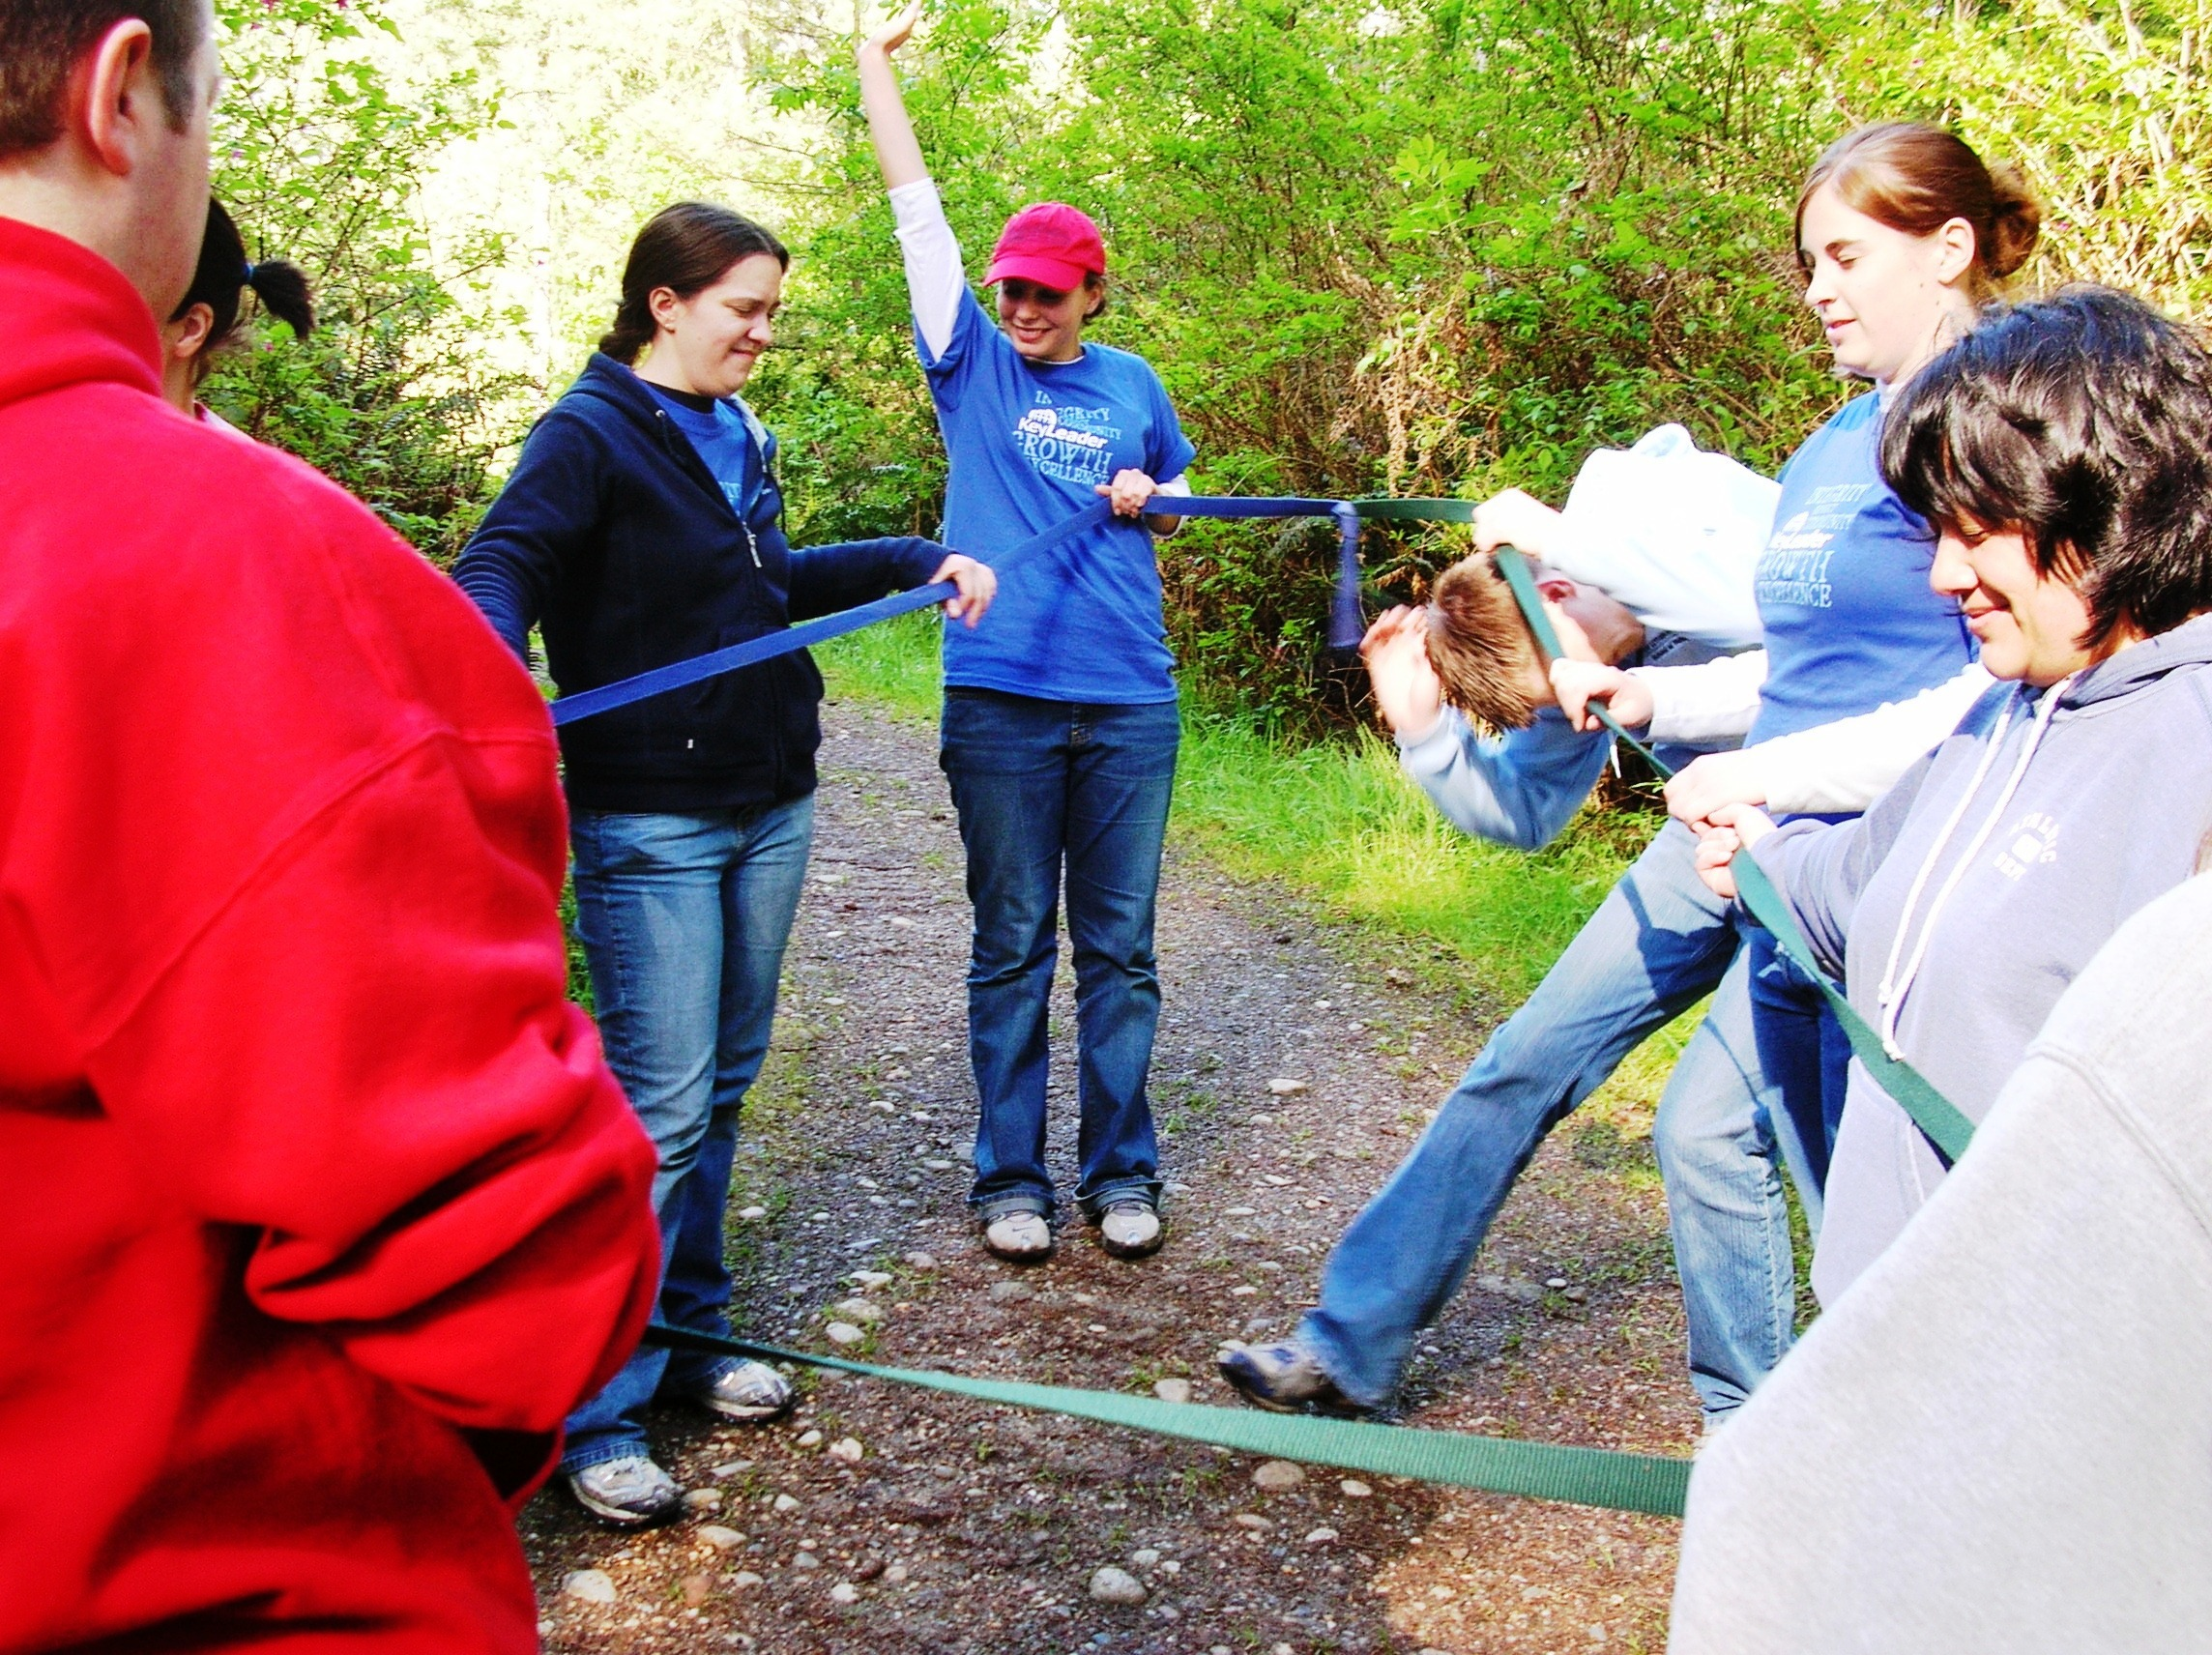
Kiwanis ROCKS!
Notes:
Kiwanis is a global organization of volunteers dedicated to improving the world one child and one community at a time. Each year the Kiwanis family dedicates more than 18.5 million hours to service and raises more than US$100 million for local and global causes. Through local and global service projects, we strive to create a lifelong commitment of caring in people of all ages and abilities.
Our Service Leadership Programs are sponsored by local Kiwanis clubs or approved community organizations, which gives members access to service-minded adults in their communities. Numerous mentoring studies have demonstrated the positive effects of having caring adults – beyond parents-as role models.
Our programs are member-led. Adult advsiors mentor and guide. Members select their leaders, plan their agendas, choose their service projects, decide when their clubs will meet and make most of the major decisions for their clubs.

Slide 2
Kiwanis youth programs are unique
Programs for all ages.
Designed to equip members with skills they can use throughout their lives.
Our programs use proven social and emotional learning techniques.
Notes:
Kiwanis’ Service Leadership Programs are unique.
Programs for all ages.
Designed to equip members with skills they can use throughout their lives.
Use proven social and emotional learning techniques.
Develop a heart to serve, answer the call to lead and summon the courage to engage.

Slide 3

Service Club Experience
Notes:
Let’s take a look at the amazing Service Club Experience.

Slide 4
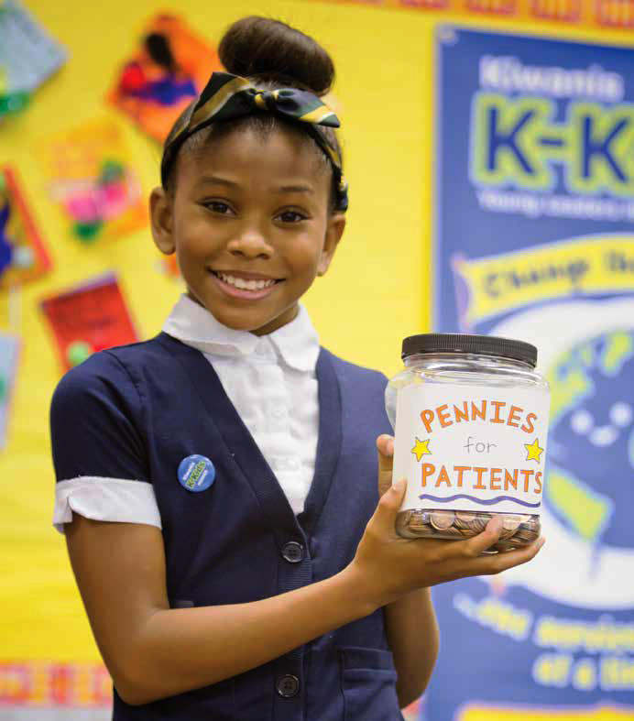

K-Kids
Elementary/Primary School
Ages 6 – 12
kkids.org
A student-led, community service club for elementary-age students.
More than 32,000 members worldwide.
Notes:
Where young leaders learn to help others
In ways large and small, K-Kids change the world around them and, in the process, transform themselves. Students lead the club, plan activities, participate in community service projects, celebrate their successes and develop empathy, self-confidence and compassion along the way. Through service to others they begin to understand the impact they can have on their school, their community and their world.

Slide 5

Bring Up Grades
Empowering young students in their academic success:
Recognizes students who raise their grades or maintain good grades from one grading period to the next.
Students set their own goals and participate in peer mentoring, which involves everyone in their success.
When they reach their goals, the entire class celebrates.
Primary/elementary school
Ages 6 - 12
bringupgrades.org
Notes:
Empowering kids in their academic success
BUG recognizes elementary students who raise their grades or maintain good grades from one grading period to the next. Students are motivated to excel because they set their own goals and participate in peer mentoring which involves their classmates in their success. When they reach their goas, the entire class celebrates.

Slide 6

Ways to support BUG
Explain the program to the classroom.
Notes:
Explain the program to the classroom.
If several classes are involved, this may need to take place in an auditorium. Discuss the date and time for this presentation. Some schools wish to explain it themselves, so be flexible.

Slide 7

Ways to support BUG
Help kids create their goals.
Notes:
Help kids create their goals.
Familiarize yourself with SMART goals (Specific, Measurable, Attainable, Realistic and Time bound) or ask the teacher whether they have some other goal-creating system that they prefer. There is plenty of information online. If classrooms need your support, create a mentoring schedule for each class involved.

Slide 8
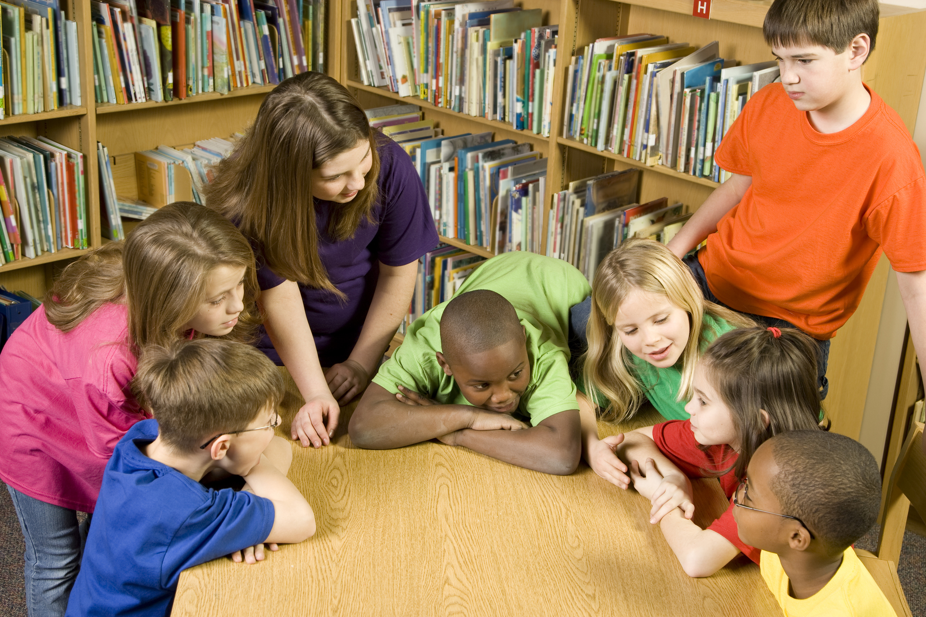
Ways to support BUG
Meet with kids to review their goals.
Notes:
Meet with the kids to review their goals.
We have provided teachers with a paper form for goal-reporting, but some prefer to conduct the check-in face to face. If classrooms need your help for this, create a mentoring schedule for each class involved.

Slide 9
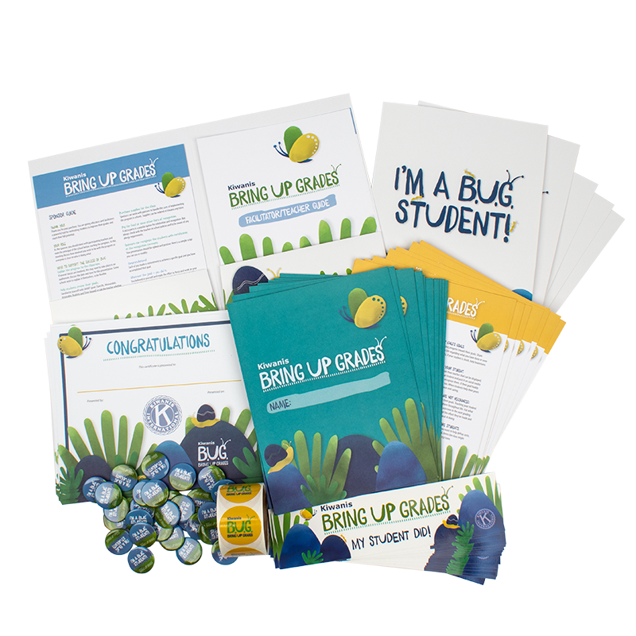
Ways to support BUG
Purchase supplies for the class.
Notes:
Purchase supplies for the class.
Sponsors can work with partners to handle the costs of implementing the program in schools. Supplies can be ordered at Kiwanis.org/store.

Slide 10
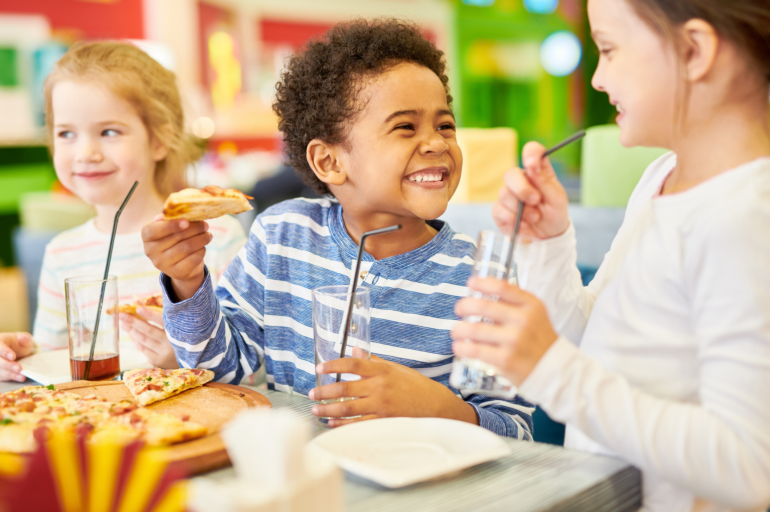
Ways to support BUG
Purchase food or other recognition.
Notes:
Pay for food or some other form of recognition.
A pizza party is a popular option for celebration and recognition. But always check with the teacher on school policies and to be aware of any allergy requirements.

Slide 11

Ways to support BUG
Recognize youth with a ceremony.
Notes:
Regcognize the kids with certificates at the recognition ceremony.
Your presentation should be upbeat and positive. Her is a sample script you can use or modify:

Slide 12

How do Kiwanis programs help youth
thrive?
Notes:
So, how do these programs help?

Slide 13
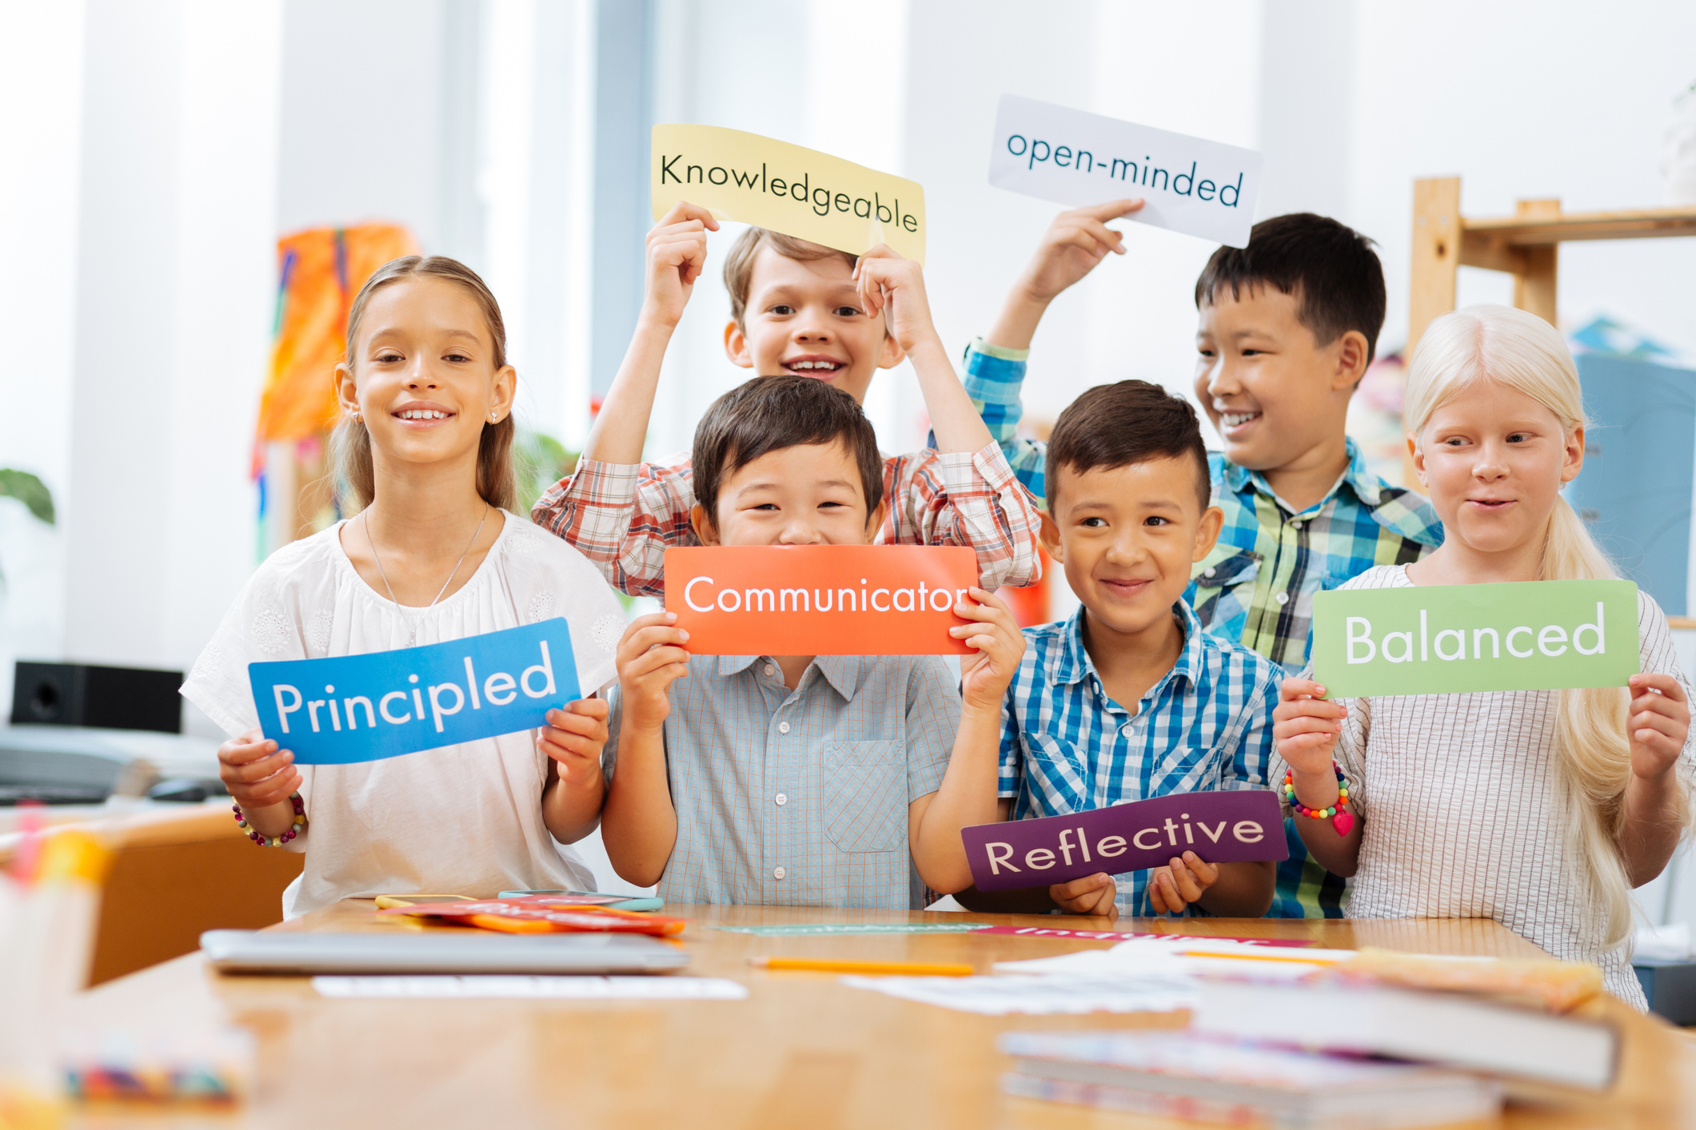
Skills youth develop
Notes:
So, how do these programs help?

Slide 14
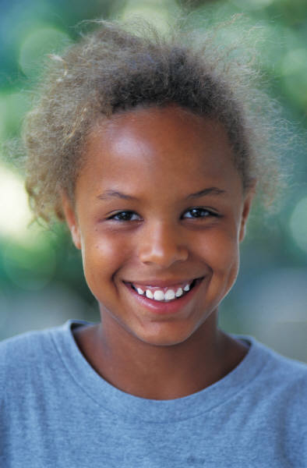
Social Emotional Skills
Self-awareness
Self-management
Responsible decision-making
Social awareness
Relationship skills
Notes:
We can develop important Social and Emotional skills.
Social Emotional Learning focuses on the development of a core set of social and emotional skills that help us in to effectively handle life challenges.
We learn to thrive in academically and socially.
These skills allow us to:
Calm ourselves when angry
Initiate friendships
Resolve relationship conflicts respectfully
Make ethical and safe choices.
Social Emotional Skills
Self-awareness – Knowing what we think and feel, and how thoughts and feelings influence actions and choices.
Self-management – Learning how to handle challenging emotions so that they don’t cause problems; being able to set goals and deal with obstacles.
Responsible decision making – Being able to come up with solutions to problems and consider the consequences of actions on ourselves and others.
Social awareness – Understanding the thoughts, feelings, and perspectives of others and developing empathy.
Relationship skills – Being able to work through conflicts; having strong connections to other people but resisting negative peer pressure.

Slide 15
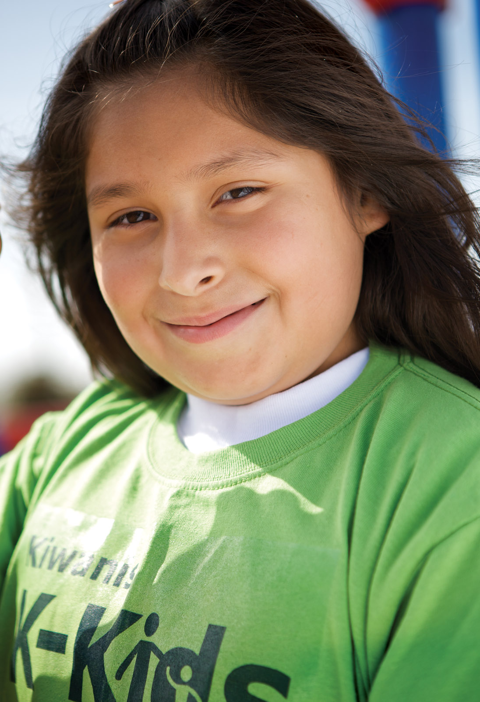
“Never doubt the power of a small group of people to change the world. Indeed, it’s the only thing that ever has.
- Margaret Mead
Thank you!
Notes:
Remember, we can make a difference. We have the ability to engage youth in kind, compassionate, caring behavior and spread happiness around the world.
Thank you.

